Slide 1


LGBTQ+ Assessment
Montgomery, TN
July 2025

Slide 2



About Embold Research
Fast. Accurate. Affordable.
Who We Are
Embold Research is the nonpartisan unit of Change Research, founded in 2017 with the mission of improving American democracy by making public opinion insights more accessible to forward-thinking leaders in all sectors of society. We are a team of pollsters, engineers, data scientists, and communications professionals. Our team brings expertise in methodological innovation, research design, public opinion, and strategic consulting.
Our Unique Approach
All of our surveys are completed online, but we do not use panels! We recruit new participants for every poll using targeted online advertisements on websites and social media platforms, and using SMS text-to-web.
Our Products
In addition to custom polling, we offer:
Magnify AI targeting (custom modeling)
Voices qualitative research (in-depth interviews and text-based chats)
ReSpark Renewable energy project viability and tracking (standardized and cost-effective polling)

Slide 3
INTRO
WHAT WE DID: On behalf of, Embold Research conducted 10 interviews and a survey of 534 registered voters from June 27 - July 2, 2025.
The IDI’s and survey's main priority include defining the local LGBTQ+ population, assessing existing resources, and engaging allies while addressing economic, housing, and social barriers such as geographic dispersal, limited queer spaces, and subtle policy discrimination.

Slide 4
METHODOLOGY
Project Phase |  | Goals
PHASE 1 | In-depth Interviews Conducted ten in-depth interviews with individuals who identified personally or their child identified as LGBTQ+ | Understand the lived experiences, needs, and priorities of LGBTQ+ individuals and parents of queer youth in Montgomery County. They aimed to identify barriers to safety, belonging, and access to affirming services, while surfacing community-driven solutions and visions for structural support.
PHASE 2 | Survey 534 registered voters in Montgomery County, Tennessee from June 27 - July 2, 2025. | Understand the experiences, priorities, and challenges of registered voters in Montgomery County, Tennessee, with a focus on LGBTQ+ inclusion. It aims to measure perceptions of community inclusivity, access to resources, safety, and support for LGBTQ+ individuals—especially youth—while also identifying barriers to participation in community life.

Slide 5

Three Core Populations In the Quantitative Survey
Registered Voters
100% of the sample. Survey was weighted to reflect the demographic makeup of Montgomery County, Tennessee
LGBTQ+ Community
48% are LGTBQ+; Parent of LGBTQ+; or someone close to them is LGBTQ+
LGBTQ+ or Parent
11% identify as LGBTQ+ or are a parent of a child who identifies as LGBTQ+

Slide 6
Gap Between Support for Inclusion and Real Action:
While many in Montgomery County say they value LGBTQ+ inclusion, there is a clear disconnect between this expressed support and actual follow-through. True inclusive practices remain unfinished business, with many LGBTQ+ residents still facing barriers to safety, resources, and community belonging
01
KEY FINDINGS

Slide 7
Gap Between Support for Inclusion and Real Action:
While many in Montgomery County say they value LGBTQ+ inclusion, there is a clear disconnect between this expressed support and actual follow-through. True inclusive practices remain unfinished business, with many LGBTQ+ residents still facing barriers to safety, resources, and community belonging
Significant Accessibility Barriers: LGBTQ+ residents struggle to access safe spaces, affordable housing, transportation, protection from discrimination, and mental health support. Youth are particularly vulnerable, with limited confidential, affirming spaces and restrictive school policies making support harder to deliver.
01
02
KEY FINDINGS

Slide 8
Gap Between Support for Inclusion and Real Action:
While many in Montgomery County say they value LGBTQ+ inclusion, there is a clear disconnect between this expressed support and actual follow-through. True inclusive practices remain unfinished business, with many LGBTQ+ residents still facing barriers to safety, resources, and community belonging
Significant Accessibility Barriers: LGBTQ+ residents struggle to access safe spaces, affordable housing, transportation, protection from discrimination, and mental health support. Youth are particularly vulnerable, with limited confidential, affirming spaces and restrictive school policies making support harder to deliver.
01
02
KEY FINDINGS
Shared Priorities Create Opportunity for Coalition: Building: LGBTQ+ community needs overlap strongly with broader voter priorities like infrastructure, growth management, economic development, homelessness services, crime reduction, and youth amenities. This alignment offers a clear chance to build unified, cross-cutting solutions that benefit everyone.
03

Slide 9
Gap Between Support for Inclusion and Real Action:
While many in Montgomery County say they value LGBTQ+ inclusion, there is a clear disconnect between this expressed support and actual follow-through. True inclusive practices remain unfinished business, with many LGBTQ+ residents still facing barriers to safety, resources, and community belonging
Significant Accessibility Barriers: LGBTQ+ residents struggle to access safe spaces, affordable housing, transportation, protection from discrimination, and mental health support. Youth are particularly vulnerable, with limited confidential, affirming spaces and restrictive school policies making support harder to deliver.
01
02
KEY FINDINGS
Shared Priorities Create Opportunity for Coalition: Building: LGBTQ+ community needs overlap strongly with broader voter priorities like infrastructure, growth management, economic development, homelessness services, crime reduction, and youth amenities. This alignment offers a clear chance to build unified, cross-cutting solutions that benefit everyone.
Consumer and Community Behavior Is Influenced by Inclusion: Residents are motivated to support businesses and organizations that demonstrate real, visible LGBTQ+ inclusion (like signage or welcoming policies). However, many feel limited by the lack of supportive options in Montgomery County. Authentic inclusion can impact purchasing choices and strengthen community ties.
03
04

Slide 10
Motivation
Our interviews and survey reveal a clear message: people in Montgomery County value inclusion—but making it happen remains unfinished business.

Slide 11
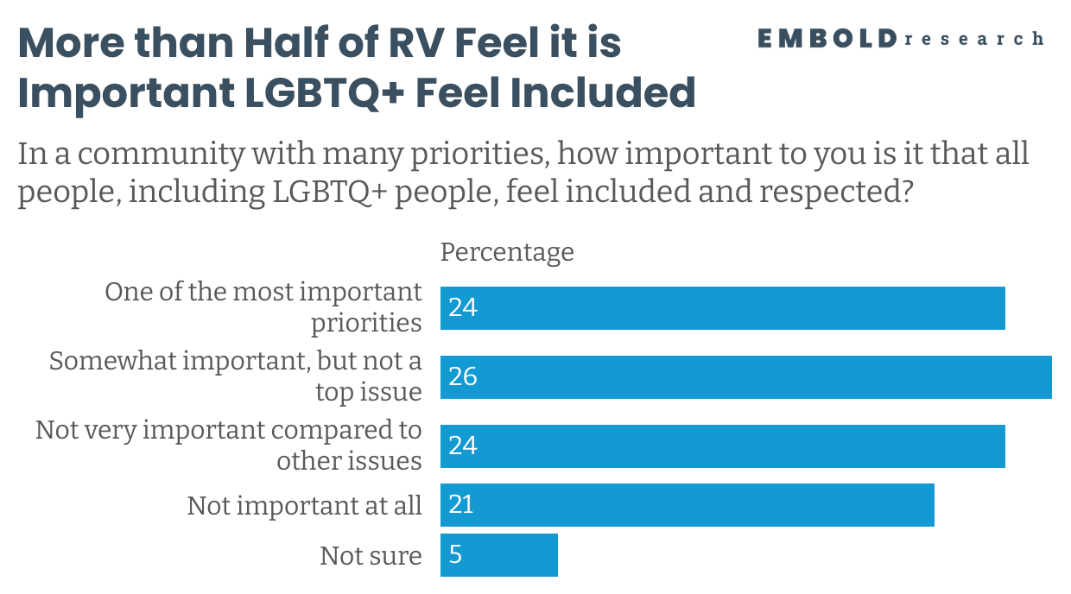

There is a Gap in Prioritization of Inclusion and Realization

Slide 12
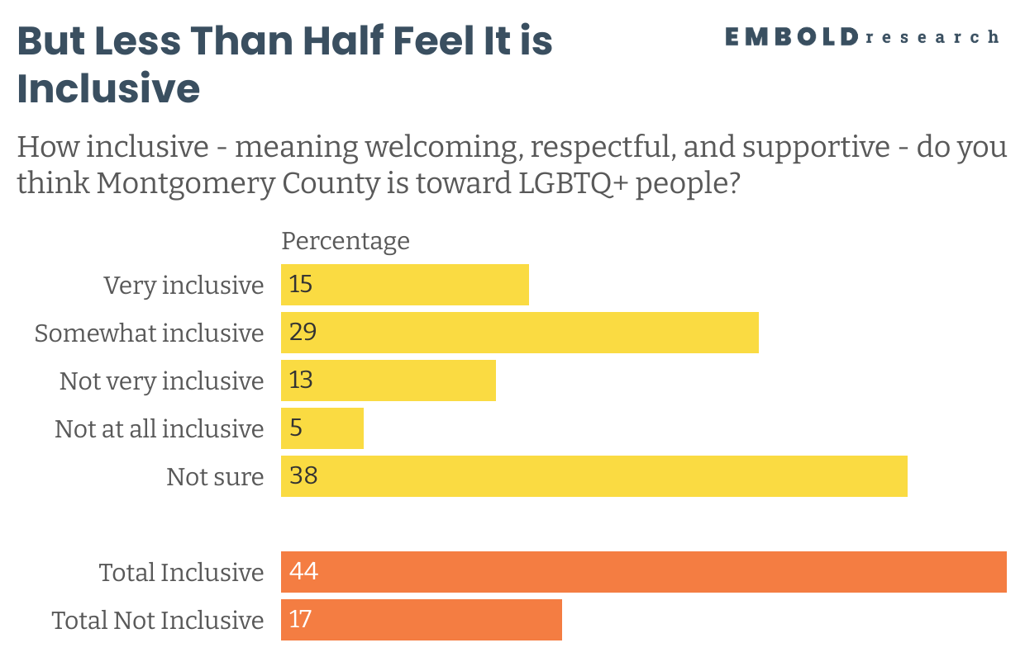
There is a Gap in Prioritization of Inclusion and Realization

Slide 13
Voters Cited Visible Support and General Kindness as Evidence of Inclusion
Visible Support & Representation: Pride flags, inclusive businesses, events, parades, university and library safe spaces "Austin Peay University is in the center of town, and is inclusive. The public library is also inclusive and feels like a safe space for people."
General Acceptance & Kindness: No overt discrimination, welcoming attitudes, Southern hospitality, treating everyone equally "Everyone is loving and welcoming here. We respect each other for our differences and nothing's better than good old fashioned southern hospitality!" “
We Don’t Single Out Groups” / Universal Inclusion: Belief that everyone is welcome without special treatment, resistance to focusing on one group "Everyone is welcome to anything, I don't think we should solely focus on what group of people to make sure they feel welcome. It should be everyone as a whole"
Personal Observation of No Problems: Haven’t seen exclusion or hate, LGBTQ+ friends doing fine, unaware of any issues "I haven't seen anything where they are not included"

Slide 14
Voters Cited Conservatism, Religiosity, and Lack of Inclusive Spaces as Evidence of Exclusion
Conservative Culture & Politics: Predominantly conservative values, Republican leadership, resistance to LGBTQ+ rights
"Because the leaders and elected officials are predominantly Republican and in this country the GOP party has made it clear they are attacking trans and LGBTQIA+ individuals."
Religious Influence & Moral Objections: Church teachings, Bible Belt culture, faith-based opposition to LGBTQ+ identities
"It's the Bible Belt and unfortunately most people of religion don't believe LGBTQ are following gods word"
Public Attitudes & Discrimination: Hostile comments, social media negativity, bullying, everyday exclusion
"The amount of hateful things I hear out in public or see on comments in community groups online"
Lack of Inclusive Spaces & Visibility: Few pride events, limited safe spaces, no visible support or cultural offerings
"No pride activities, parades, etc. Comments from notable members of the community."
Systemic & Institutional Barriers: Policies, local laws, leadership rhetoric, perceived indifference to rights
"There is a lot of accepted hate and discrimination towards the LGBTQ community by county level officials and locals."

Slide 15
Top Issues
Infrastructure, growth management, economic development, homelessness, crime, and youth amenities are the highest priorities for local voters.

Slide 16
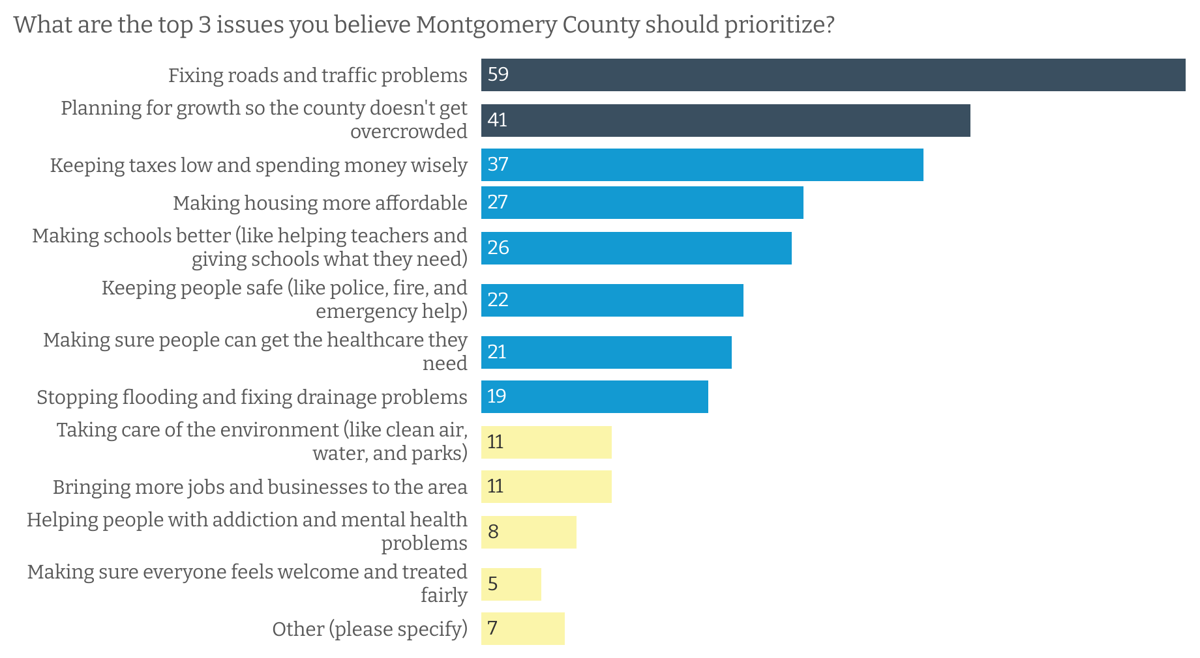
Infrastructure Tops the List of Voter Priorities

Slide 17
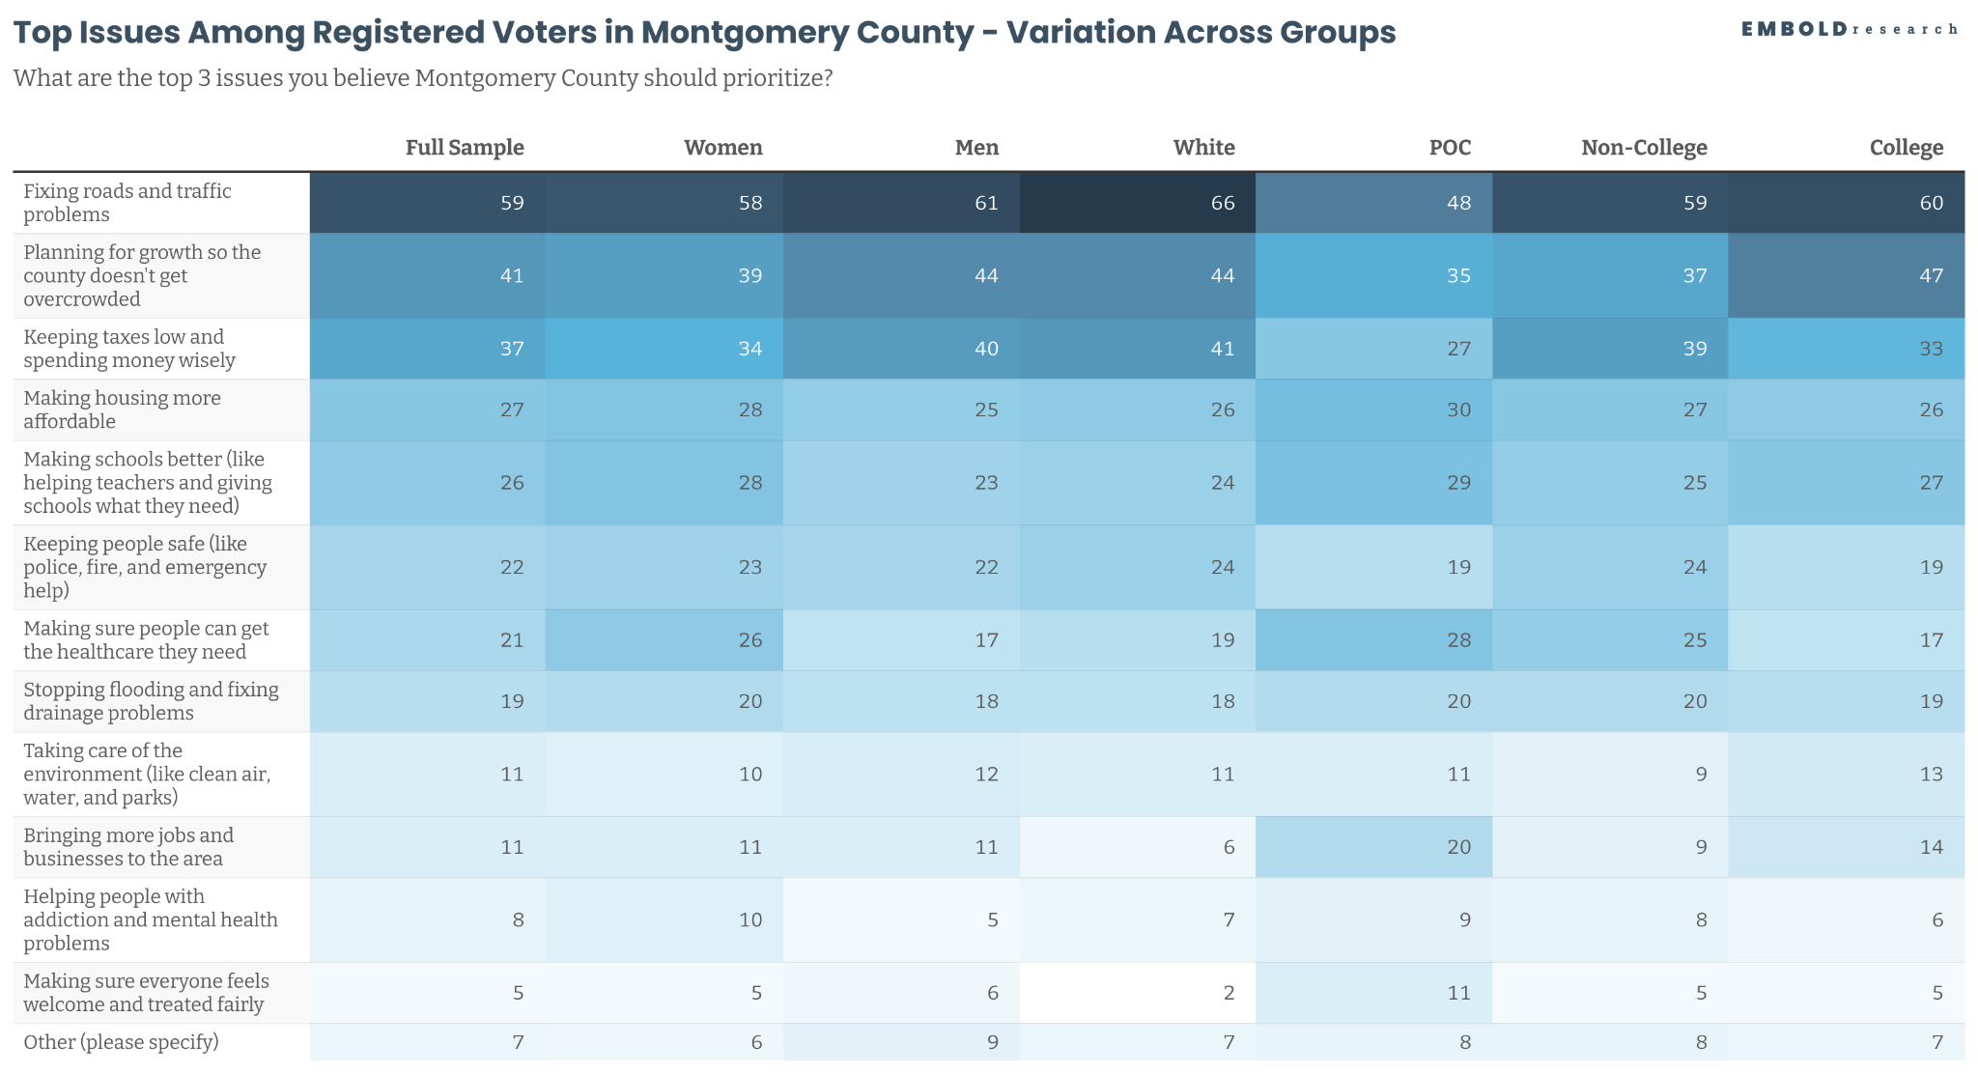

Slide 18
Infrastructure & Growth Management: Fix roads, stop overbuilding, plan for growth
Economic Development & Jobs: Attract businesses, white-collar jobs, higher pay
Homelessness & Social Services: Address downtown homelessness with support services
Crime & Safety: Reduce crime, improve enforcement, enhance neighborhood safety
Youth & Community Amenities: More parks, sports facilities, safe spaces for youth
Key Insights From the ‘Other’ Field
Analysis of the open-ended option for other issues reveals core themes.

Slide 19
Accessibility of Key Resources
While access to vaccinations, insurance, and healthcare services is reported as easier, the findings highlight clear disparities that call for targeted efforts in the areas where need for access is most evident.

Slide 20
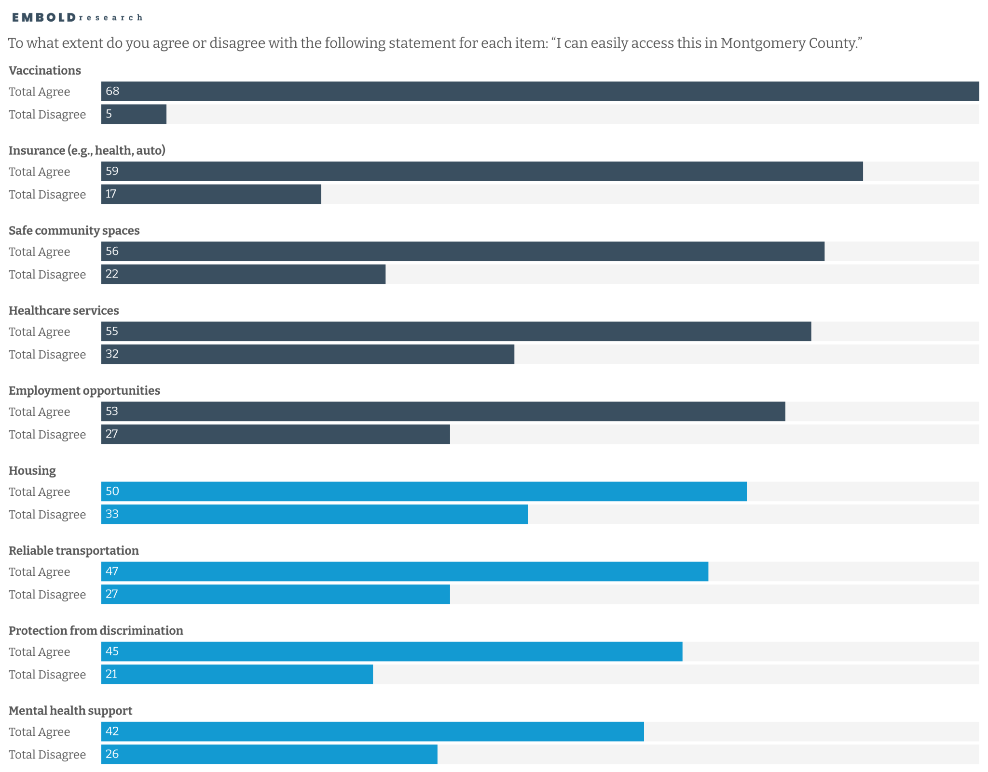
More than half of voters agree they can easily access vaccinations, insurance, safe community spaces, healthcare, and employment
Halk or less say they can easily access housing, transportation, protection from discrimination, and mental health support
Half or less say they can easily access housing, transportation, protection from discrimination, and mental health support

Slide 21
More than half of voters agree they can easily access vaccinations, insurance, safe community spaces, healthcare, and employment
Halk or less say they can easily access housing, transportation, protection from discrimination, and mental health support
Half or less say they can easily access housing, transportation, protection from discrimination, and mental health support

Slide 22
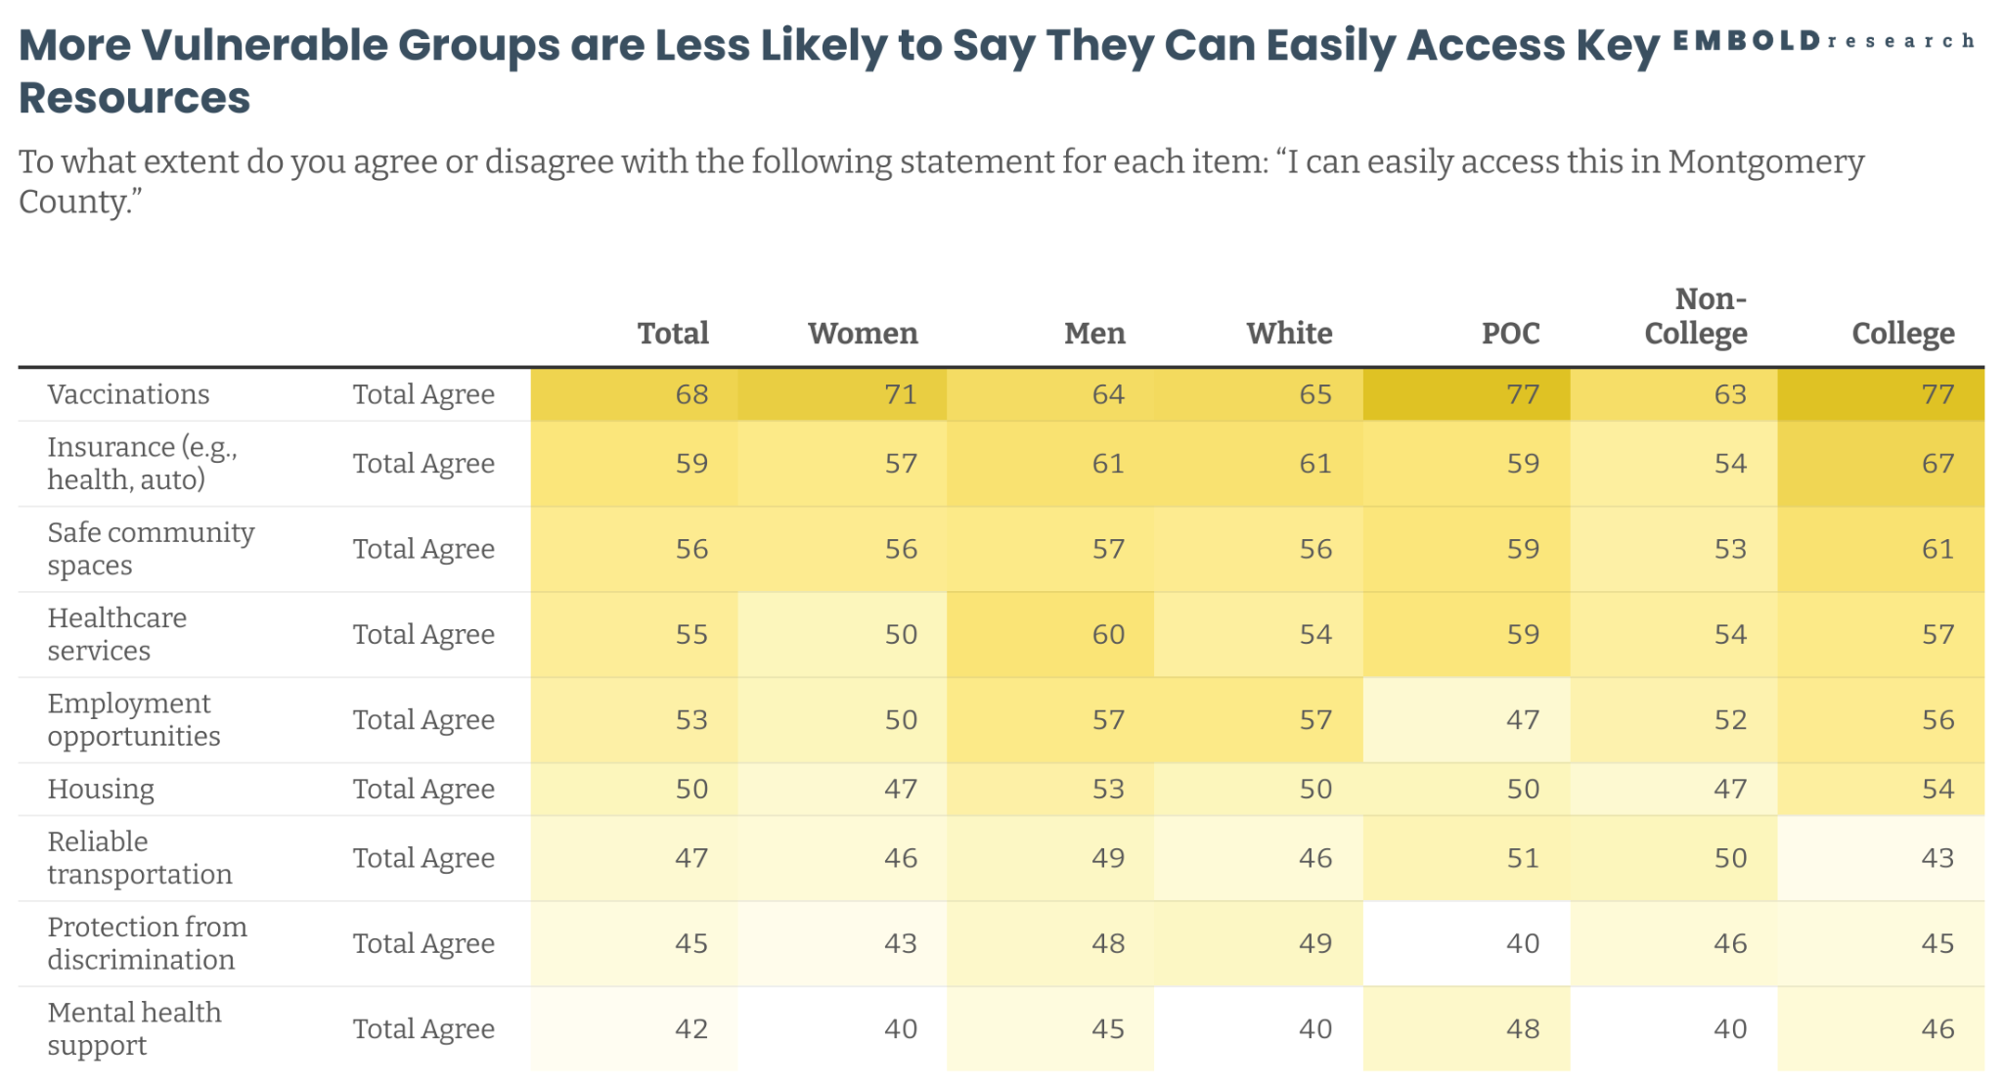

Slide 23
Accessibility of Key Resources for LGBTQ+ Community
The most noted resource perceived to be needed for the LGBTQ+ community in Montgomery County is Mental Health Support

Slide 24
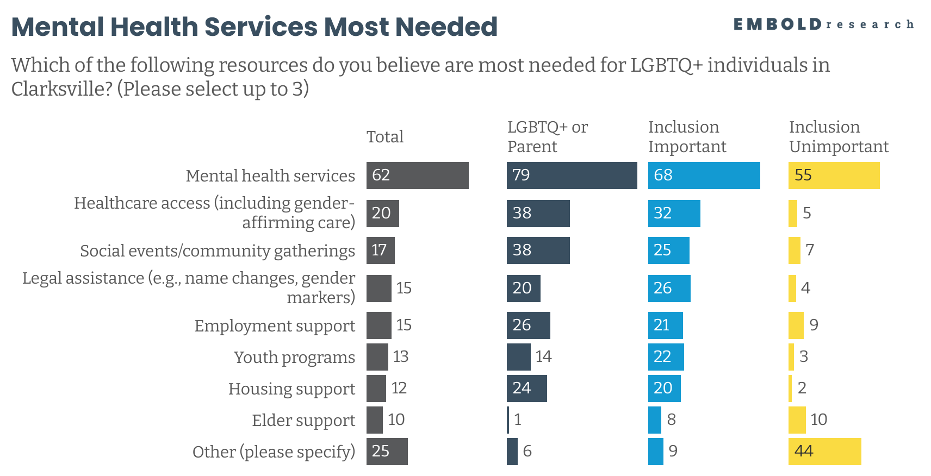
Qualitative Data Insight
Interviews highlighted the additional stress that LGBTQ+ youth face and how parents can worsen mental health challenges, with one teacher in Montgomery County explaining that “I have had parents say to me that they would rather have a dead kid than a queer kid, in that joking way that they think is funny, like it's not a problem.”

Slide 25
Equality & Fairness: Same access for all, no special treatment, equal resources
Religious & Moral Objections: Faith-based values, conversion therapy, repentance
Hostile or Dismissive: Insults, slurs, rejection of LGBTQ support
Apathy & “Don't Know”: Indifferent, unsure, dismisses issue
Critique of Question / Issue Deflection: Rejects premise, prioritizes other concerns
Other / N/A: Blank, “None,” unclear responses
Key insights from the ‘Other’ field
Analysis of the open-ended option for other issues reveals core themes.

Slide 26
LGBTQ+ Lived Experience with Accessibility
LGBTQ+ persons state that struggle access most resources but in particular housing, transportation, and safe spaces

Slide 27
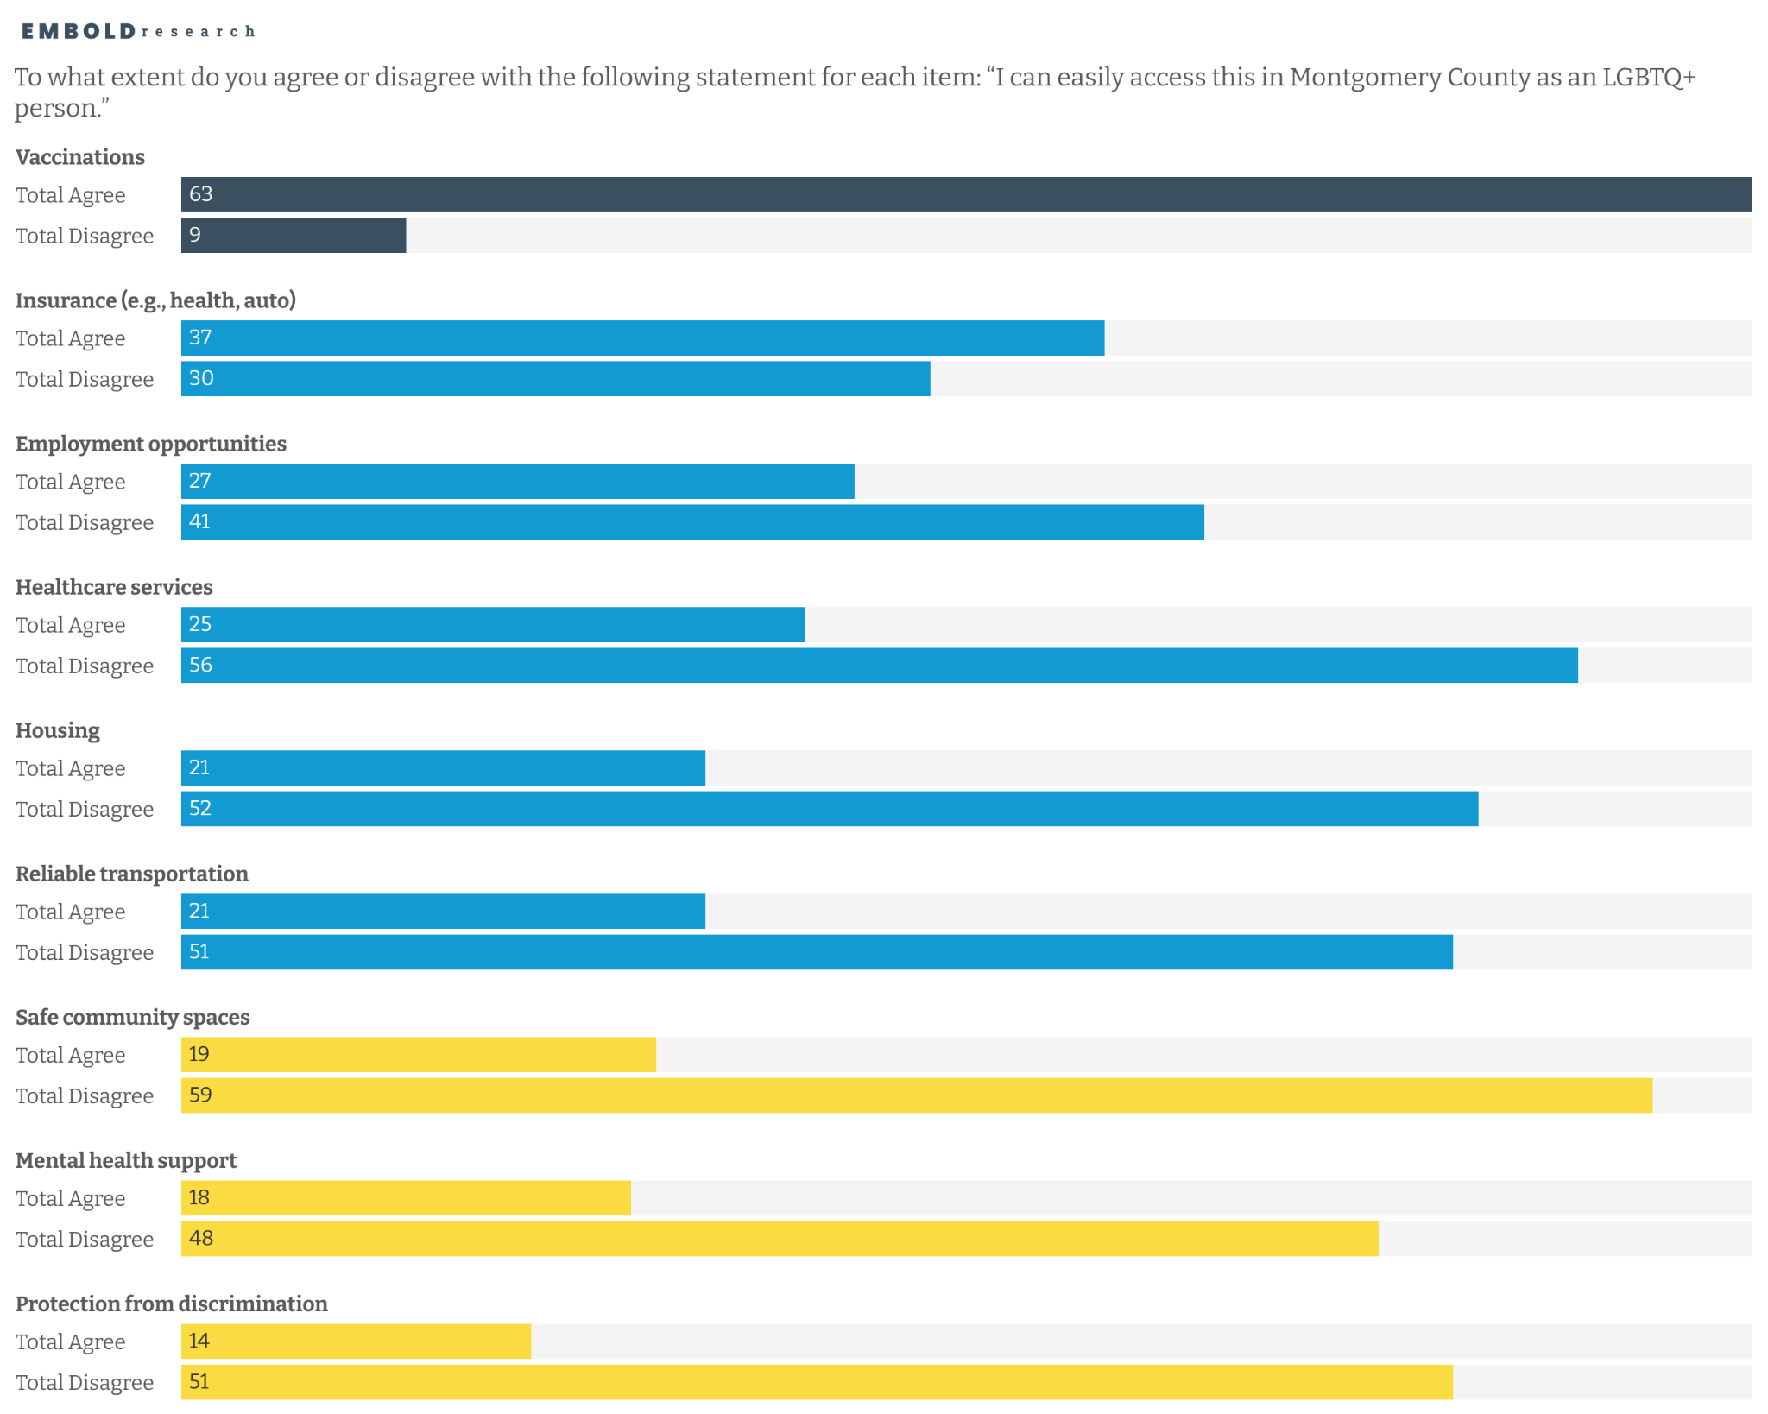
LGBTQ+ peoples can easily access vaccinations.
Qualitative Data Insight
Some participants did highlight positive experiences with healthcare workers: when it comes to like the healthcare industry, I've noticed people within the healthcare industry tend to be more accepting. …I feel like doctor's offices somewhat cuz I feel like then and there people I feel like I feel like they tend to be more accepting like I said in the medical field.

Slide 28
LGBTQ+ peoples can easily access vaccinations.
Least accessible are safe community spaces, mental health support, protection from discrimination.

Slide 29
Perceived Safe Spaces
Colleges, Coffee Shops, and Libraries are perceived as safe spaces for LGBTQ+, whereas local government offices and religious institutions are not.

Slide 30
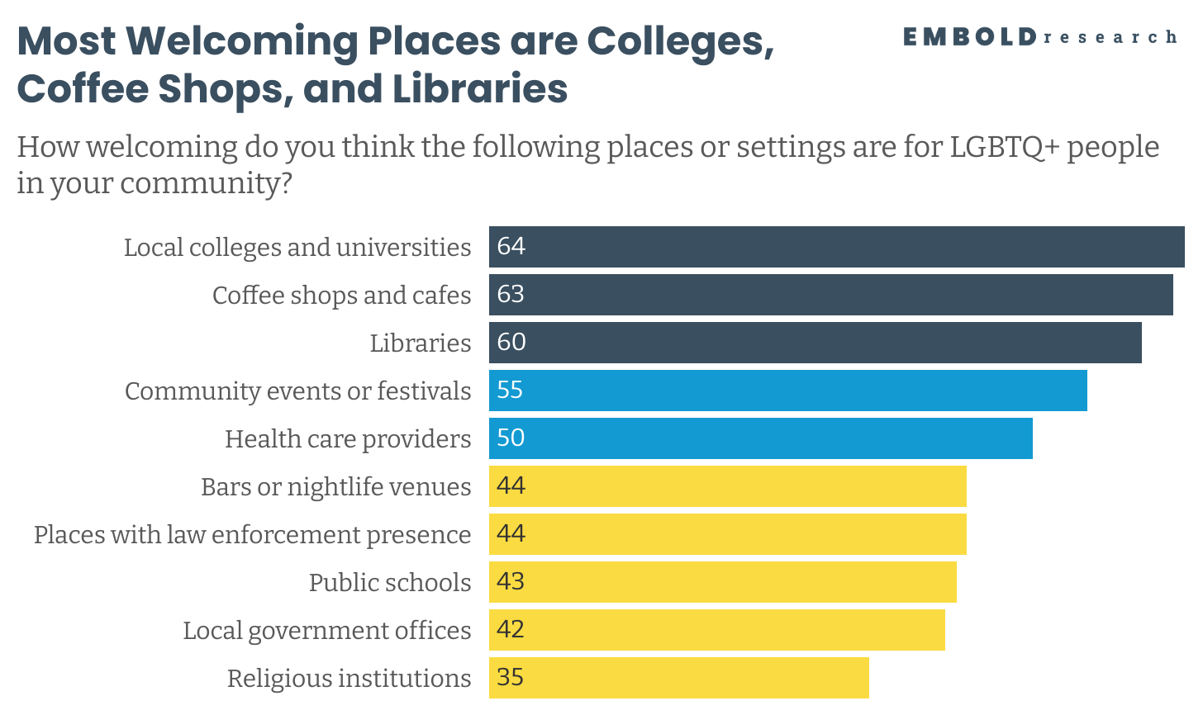
Qualitative Data Insight
According to interviews, spaces with more feminine and liberal cultural coding were often perceived as safe. Participants mentioned places like craft fairs with “spooky” themes and farmers markets as inclusive environments where they felt more comfortable expressing themselves.

Slide 31
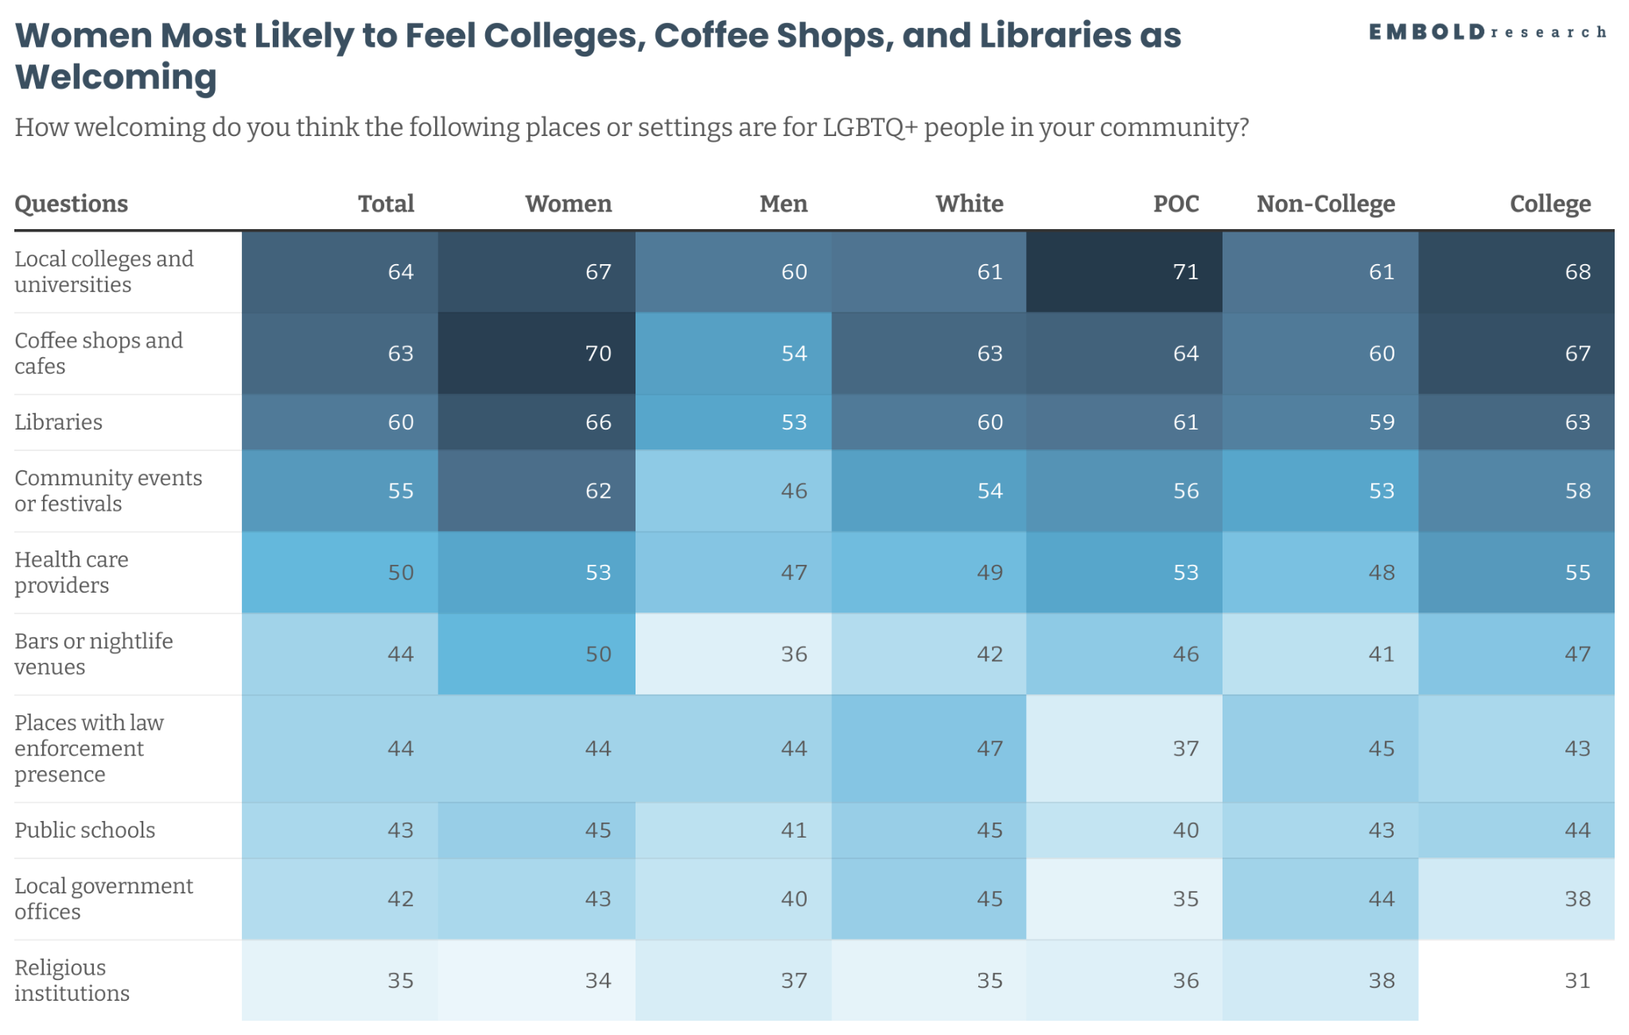

Slide 32
Perceived Challenges for LGBTQ+ Youth And Needed Resources
Those closest to young peoples have growing concerns about the lack of youth spaces and changing support from adults in school systems

Slide 33
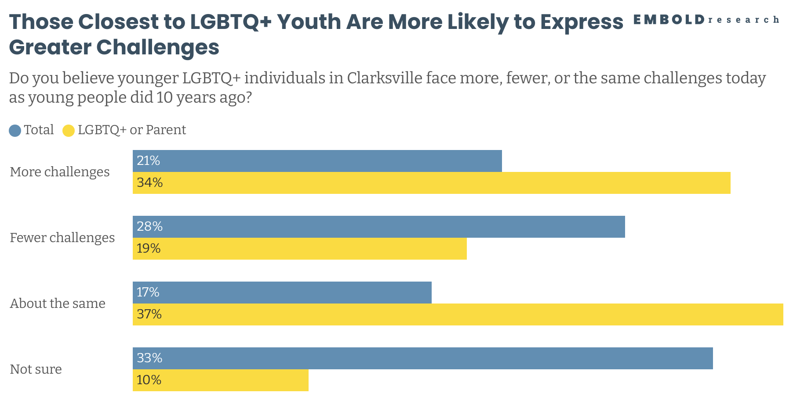
Qualitative Data Insight
Participants—particularly parents of LGBTQ youth—voiced increasing concern over school policies that exacerbate the isolation of vulnerable students. The interviews reveal a clear divide between youth with supportive, resource-rich home environments and those lacking such support. Policies are also limiting the ability of community actors to reach and assist the most vulnerable populations.

Slide 34
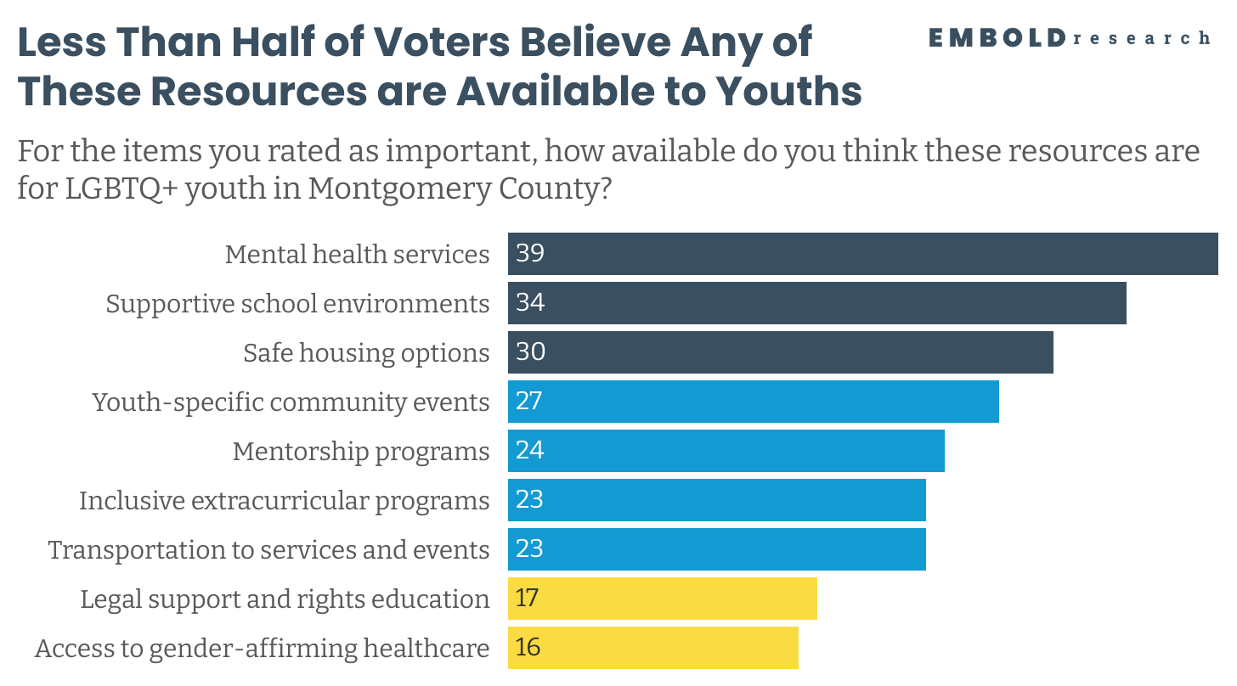
Qualitative Data Insight
The need for consistent, confidential, and queer-affirming spaces for youth—both physical and emotional—was clear across interviews. One participant said: Ever since I moved here, I have heard people… say there is nothing for kids to do that doesn't cost them money here.”

Slide 35
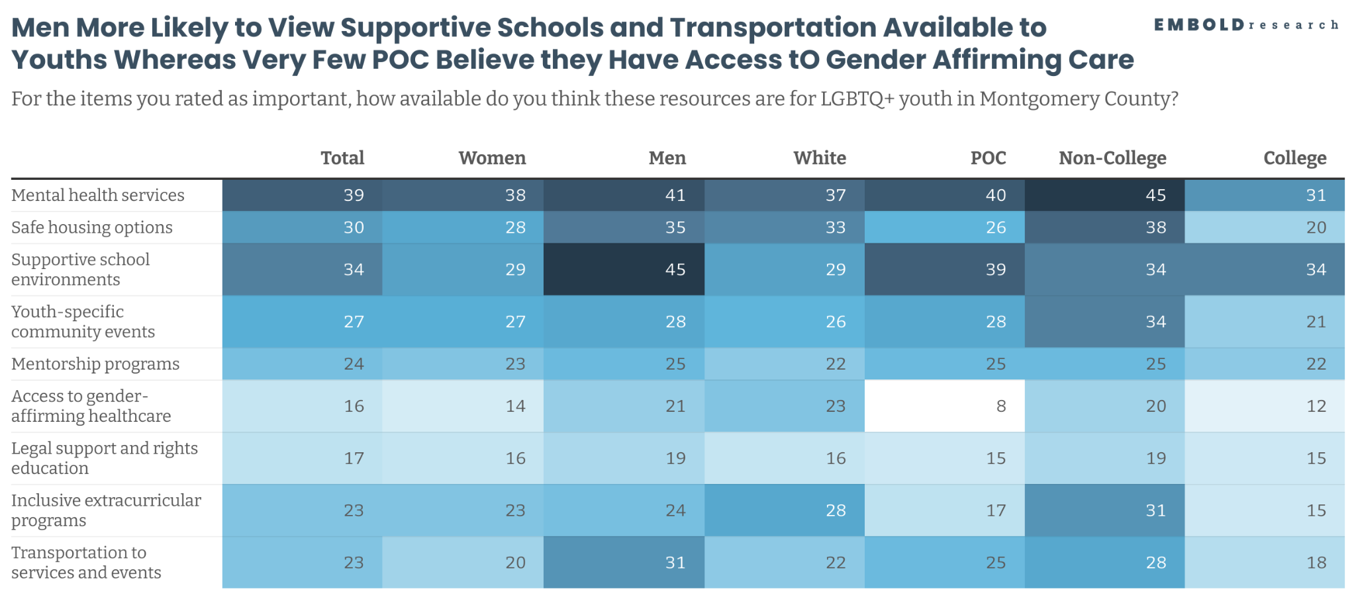
Qualitative Data Insight
Interviews highlight that schools, which were once safe spaces where youth experiencing challenges with their identity at home could find support from adults, are increasingly constrained by policies that make such support more difficult. Alternatively, peers are now often described as more supportive.

Slide 36
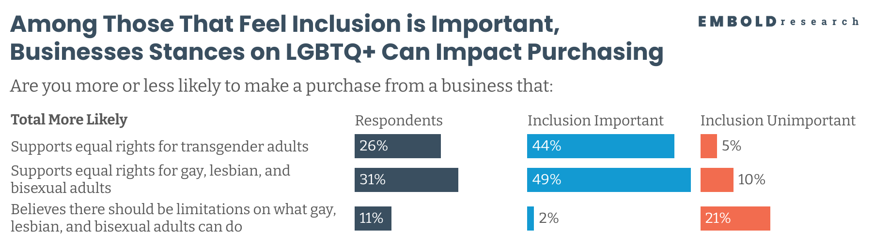
Qualitative Data Insight
Many interviewees said they want to shop only at supportive businesses but feel limited by the options available in Montgomery County. Those who are more economically marginalized also expressed frustration about being unable to shop at more inclusive places and about being excluded from community events due to cost.

Slide 37
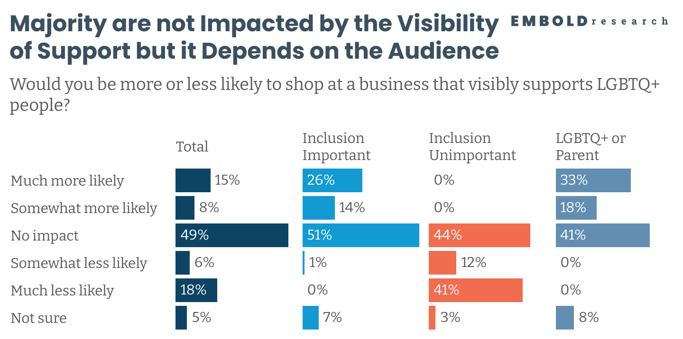
Qualitative Data Insight
During interviews, participants indicated that they rely on markers such as stickers or familiarity with the owner's identity to determine whether a place is safe, particularly for trans individuals. One individual mentioned: “We have a couple [businesses] that will have like you know those cheesy stickers. ‘Everyone is welcome here,’ which… it’s great to know that people will treat me good and I would appreciate seeing more of that.”

Slide 38
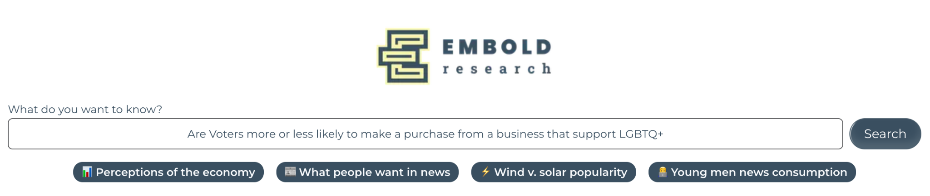
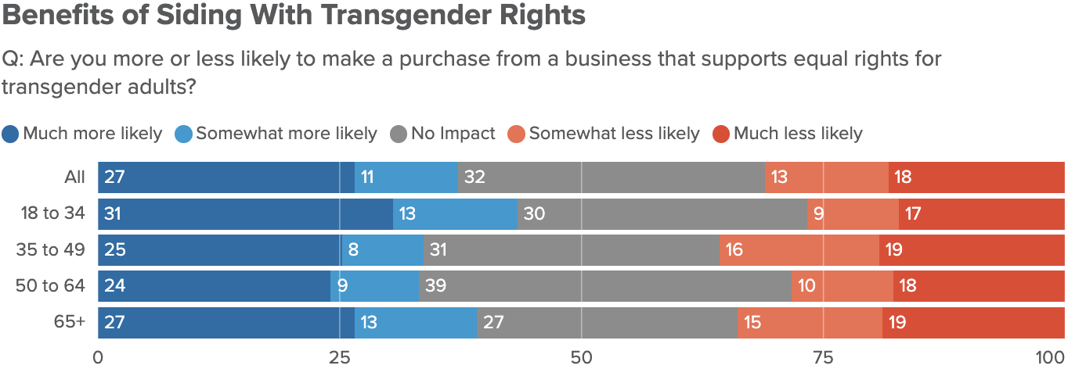
Your Complete Polling Archive
Embold Research Data Portal
Millions of data points at your fingertips—giving you instant access to your complete polling archive, a massive dataset of survey responses on policy and politics, and an AI-powered search tool that surfaces insights and trends in seconds.

Slide 39
Path Forward:
Better Communication about Community Events Hosted in Spaces Perceived as Welcoming.

Slide 40
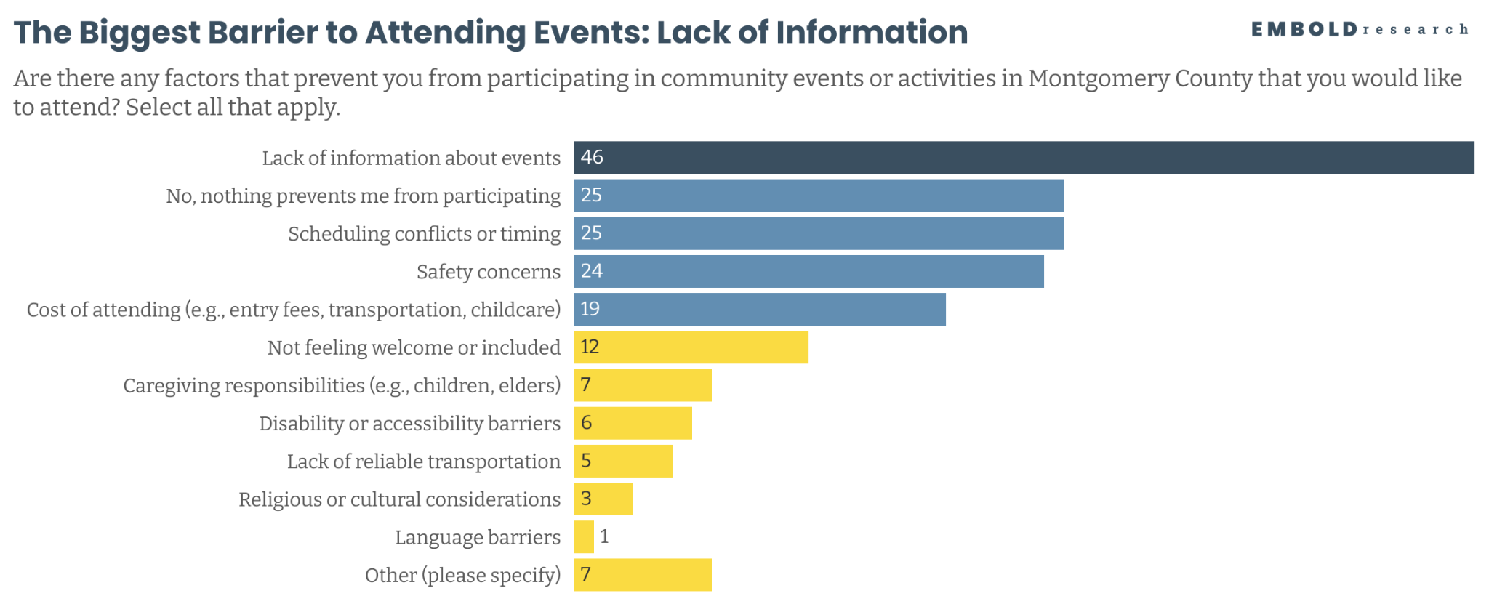
Qualitative Data Insight
Lack of information was frequently underscored in interviews with one participant highlighting: “It really is a lot of it word of mouth. … You really have to be in the know to even like expect that to be a thing you could find. …”

Slide 41
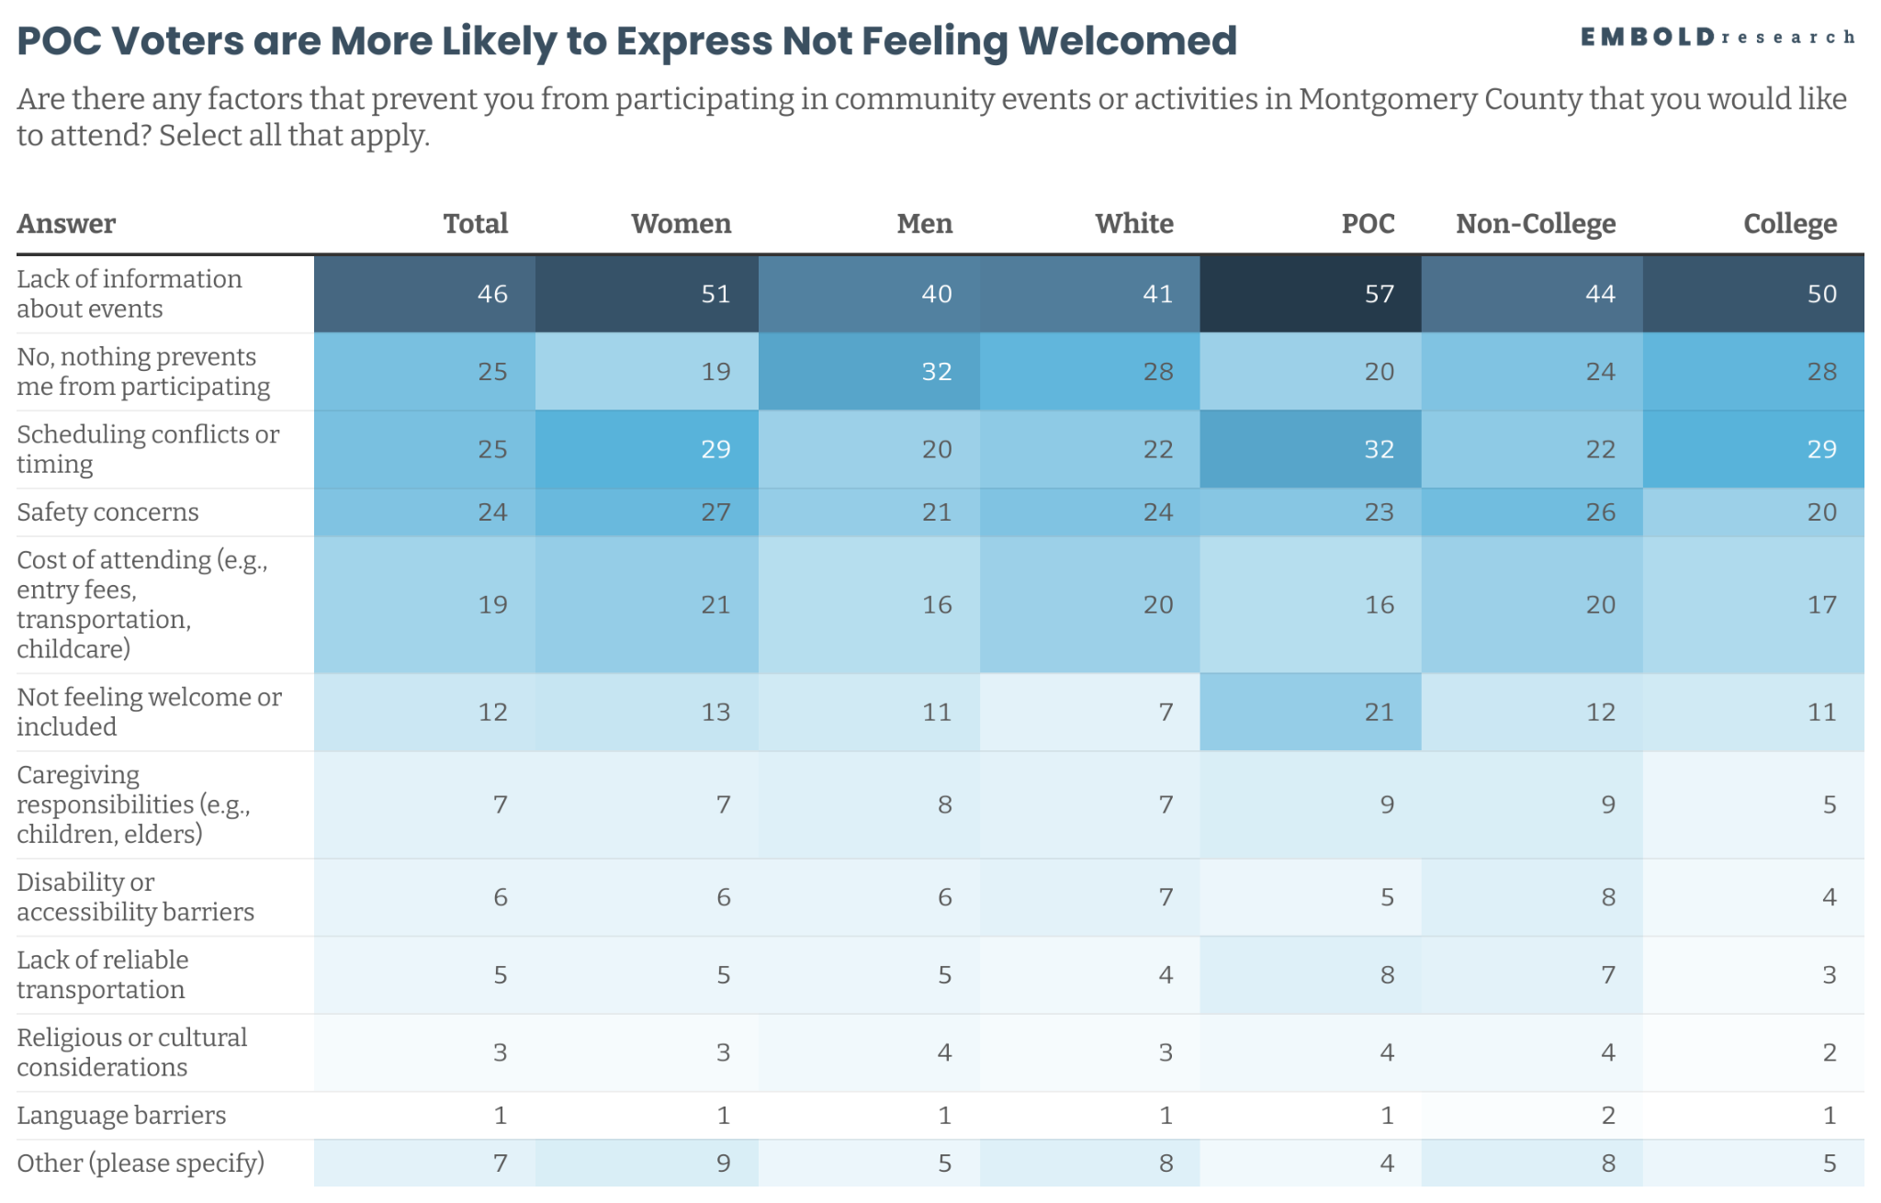
Qualitative Data Insight
Interviews noted barriers within community spaces for people with multiple marginalized identities. One participant said: “even if you're openly okay with gay people, you might not be okay with black people or vice versa.”

Slide 42
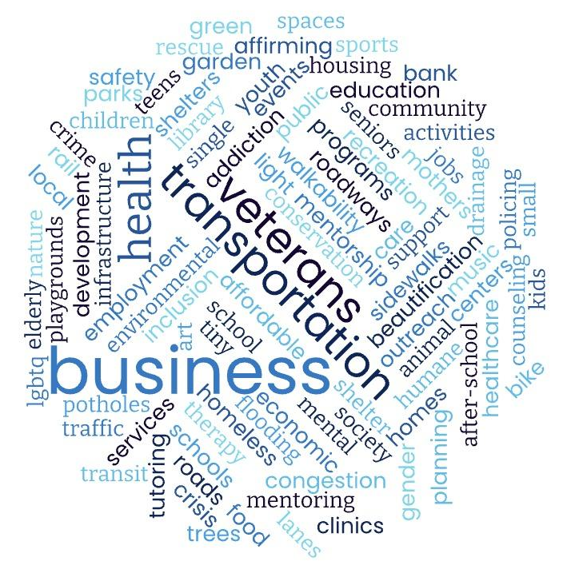
If you were given $1 million to invest, what would you do..?
Infrastructure & Traffic: Road repairs, congestion relief, drainage improvements, sidewalks, better planning
Youth & Education Support: After-school programs, mentorship, youth centers, school funding, alternative education pathways
Housing & Homelessness: Affordable housing, shelters, tiny home villages, support for veterans, addressing homelessness
Mental & Physical Health Services: Mental health access, healthcare facilities, crisis support, addiction treatment, gender-affirming care
Community Spaces & Recreation: Parks, playgrounds, sports facilities, community centers, beautification projects, art programs

Slide 43
RECOMMENDATIONS
Inclusive, Whole-Community Youth Events: Develop free, accessible youth programs—like art nights, sports leagues, or volunteer opportunities—led by inclusion-trained adults to ensure all youth feel welcome and safe without needing to label themselves.
Strengthen Communication Channels: Invest in clear, centralized, and multilingual event promotion that doesn't rely solely on social media or word-of-mouth, ensuring even newcomers or those without online access know what's available.
Make All Community Events and Spaces More Accessible: Require event planners to consider physical, sensory, financial, and language accessibility from the start, offering sliding-scale admission and low-sensory zones to remove barriers for all.

Slide 44
RECOMMENDATIONS
Establish a Dedicated LGBTQ+ Community Center: Prioritize creating a fully accessible, centrally located community center that offers 24-hour safe space, mental health support, crisis response, and cultural programming designed by and for LGBTQ+ residents.
Expand Alternative Safe Spaces for Youth Support: Recognizing that schools are increasingly constrained by legislation, invest in community centers, libraries, and other public venues to host inclusive, confidential, and affirming programs where LGBTQ+ youth can safely connect with peers and trusted adults.
Center Intersectional Inclusion in All Efforts:
Recognize and address the differences in experience between LGBTQ+ individuals who can “pass” and those whose queerness intersects with other marginalized identities like race, disability, or immigration status, ensuring programs and spaces are intentionally designed to be inclusive and affirming for all.

Slide 45
THANK YOU
QUESTIONS?

Slide 46

ABOUT US
Embold Research
Lead with data. Get things done.
Embold Research is a team of data scientists and communications professionals with deep experience helping leaders translate data into actionable insights.

