Slide 1

Notes:
Chas begins

Slide 2
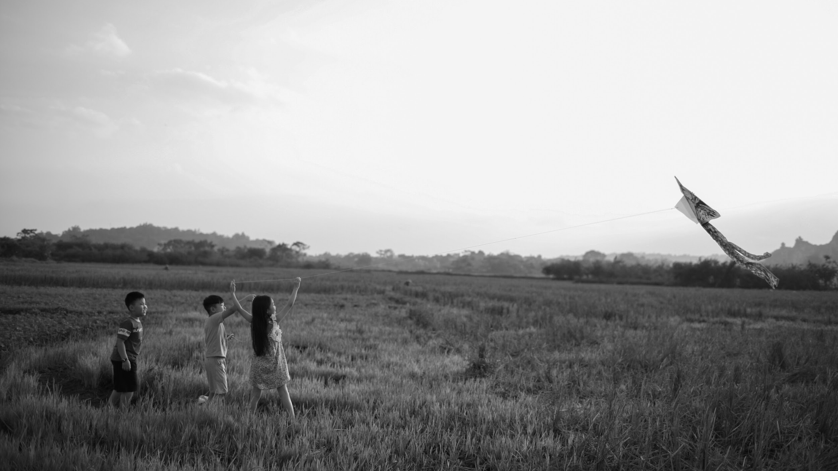

LGBTQ+ Assessment
Montgomery, TN
Link to longer presentation here and Qualitative Report here
July 2025
Notes:
Chas begins

Slide 3
METHODOLOGY
Project Phase |  | Goals
PHASE 1 | In-depth Interviews Conducted ten in-depth interviews with individuals who identified personally or their child identified as LGBTQ+ | Understand the lived experiences, needs, and priorities of LGBTQ+ individuals and parents of queer youth in Montgomery County. They aimed to identify barriers to safety, belonging, and access to affirming services, while surfacing community-driven solutions and visions for structural support.
PHASE 2 | Survey 534 registered voters in Montgomery County, Tennessee from June 27 - July 2, 2025. | Understand the experiences, priorities, and challenges of registered voters in Montgomery County, Tennessee, with a focus on LGBTQ+ inclusion. It aims to measure perceptions of community inclusivity, access to resources, safety, and support for LGBTQ+ individuals—especially youth—while also identifying barriers to participation in community life.
Notes:
Community that is being talked about instead of talked to
We did interviews and a survey. The survey was for everyone so we could compare

Slide 4
Heightened Vulnerability
LGBTQ+ youth are especially at risk, facing limited confidential and affirming spaces alongside restrictive school policies that make support harder to deliver
School Environment Barriers: Schools, once safe havens, are increasingly constrained by legislation and policy. Adults have fewer opportunities to offer support, leaving peers as the primary source of affirmation for many youth
01
02
KEY FINDINGS
Lack of Critical Resources: LGBTQ+ youth often lack access to essential supports, including mental health care, safe housing, supportive schools, community events, and gender-affirming care.
Urgent Need for Safe & Inclusive Youth Spaces: Data finds a need for consistent, confidential, queer-affirming youth programs and free community activities. Residents also prioritize youth support through after-school programs, mentorship, and youth centers
03
04

Slide 5
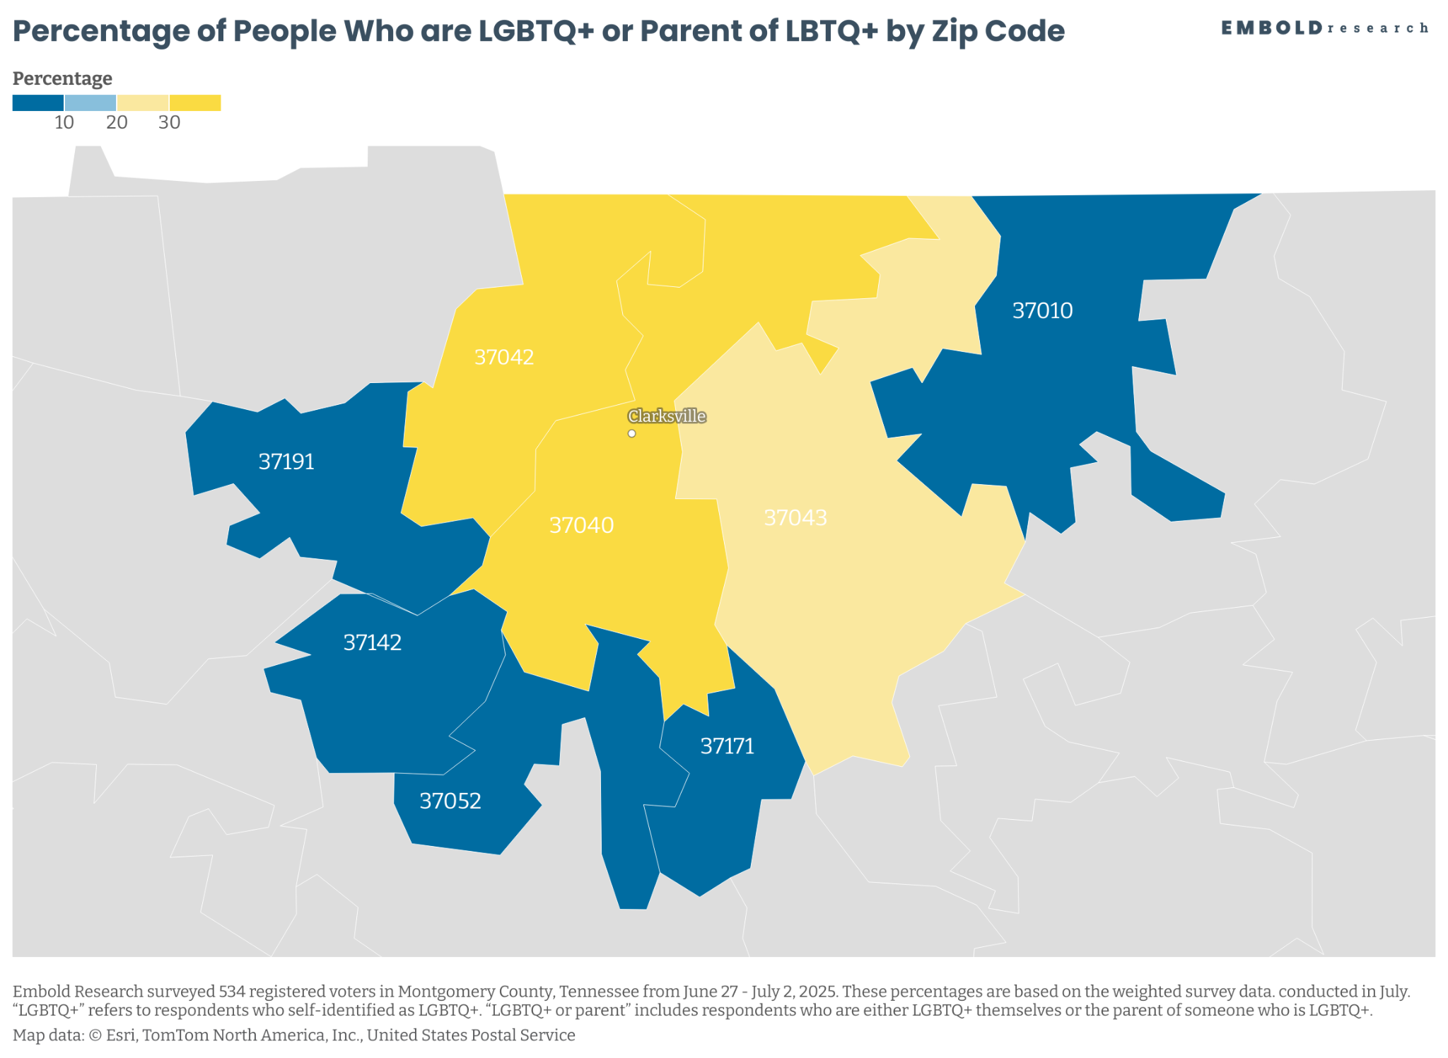
Notes:
Inclusion is more than talking about it
Critical services are harder to access for lgbtq+ folks
We see the same problems as you
Our people and allies want to support inclusive leaders and businesses

Slide 6
LGBTQ+ Lived Experience with Accessibility
LGBTQ+ persons state that struggle access most resources but in particular housing, transportation, and safe spaces

Slide 7
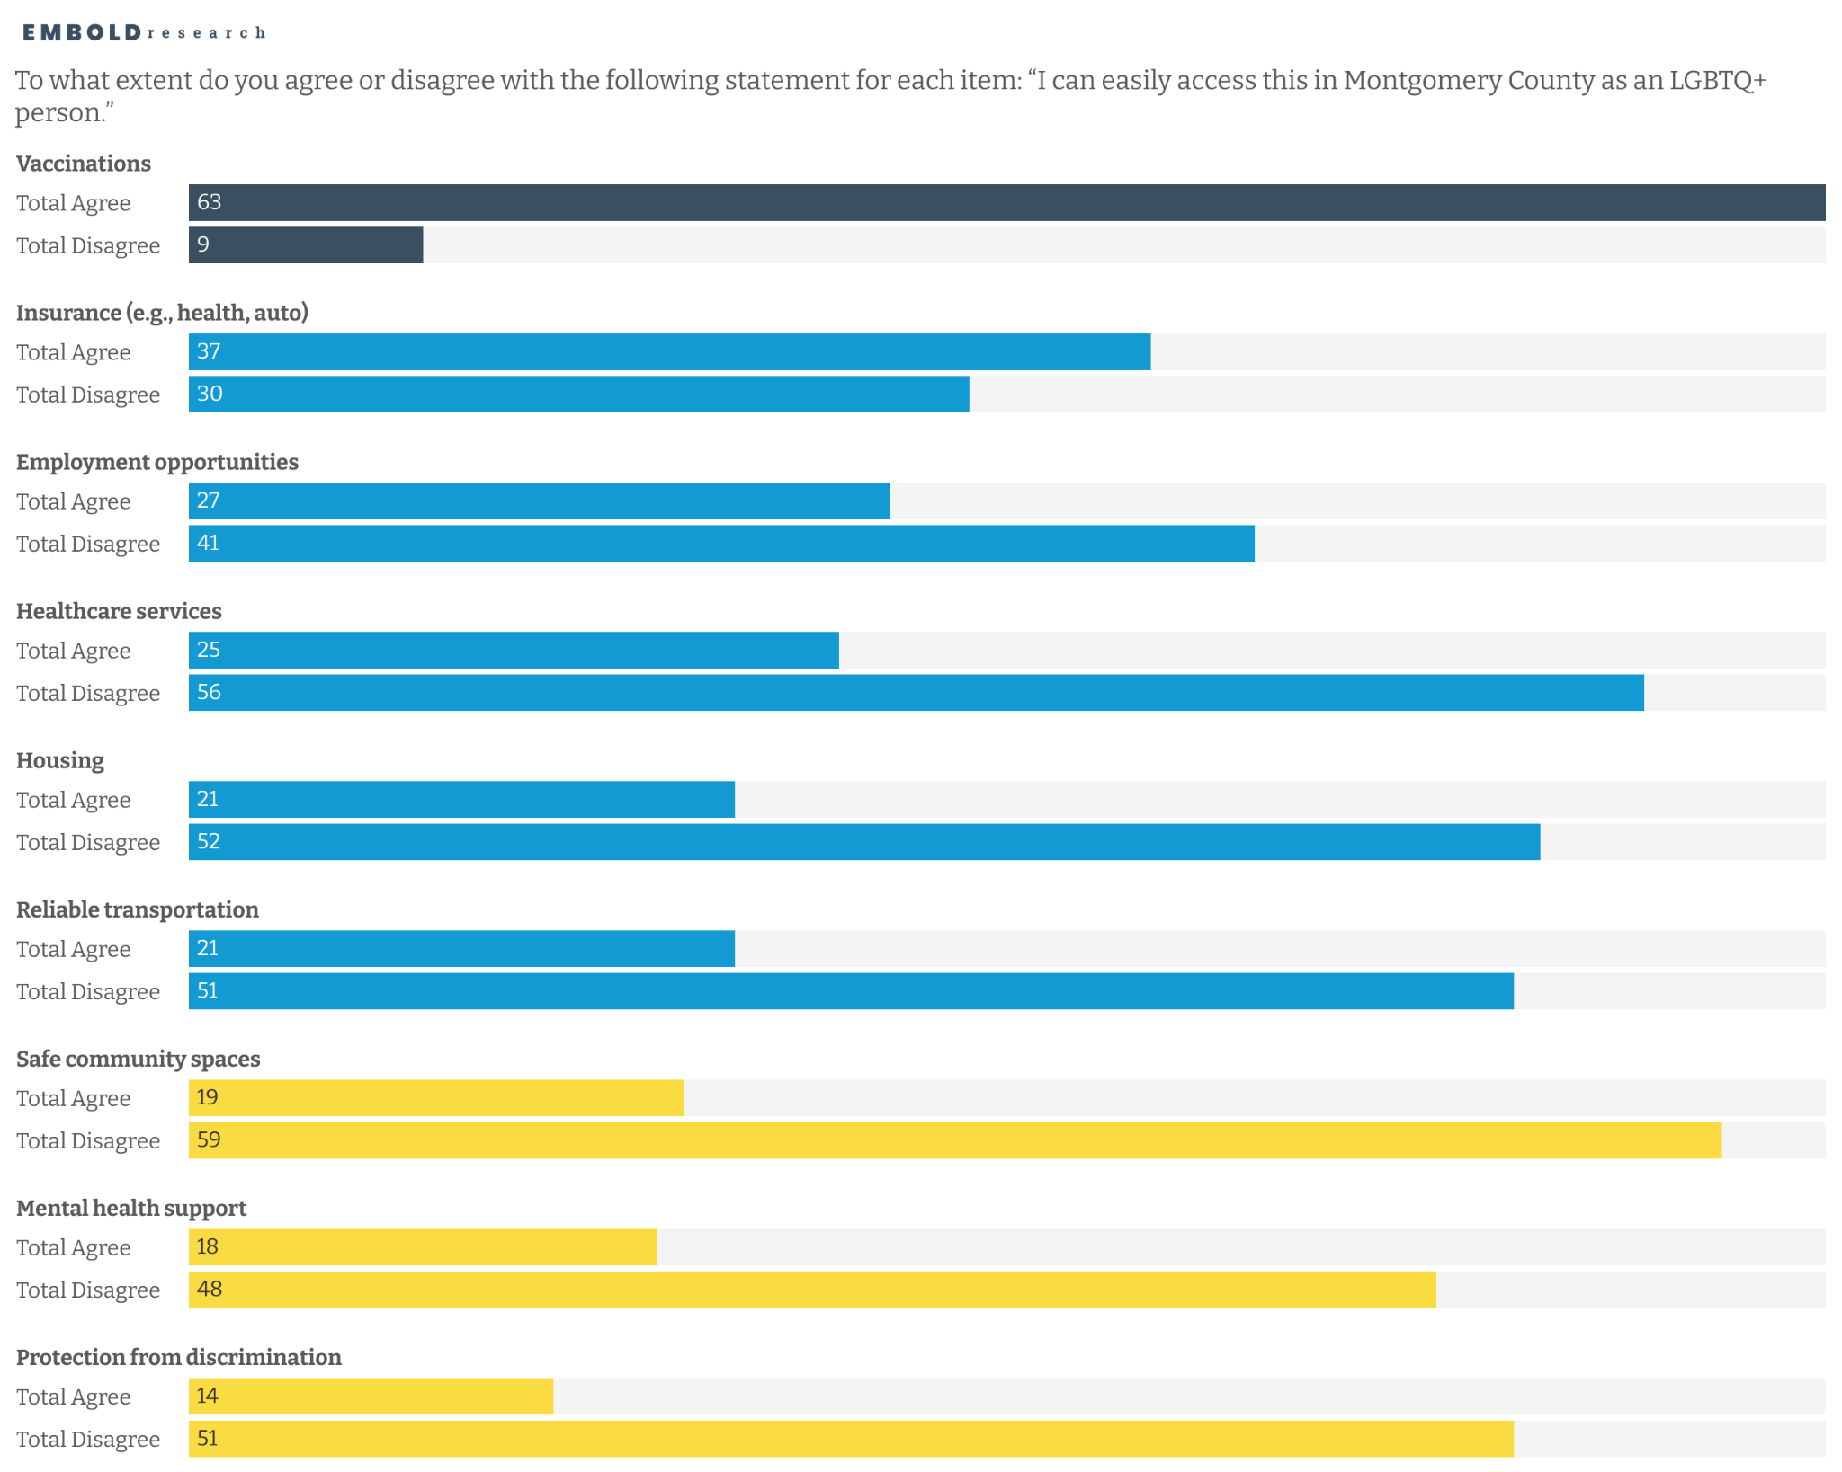
LGBTQ+ peoples can easily access vaccinations.
Qualitative Data Insight
Some participants did highlight positive experiences with healthcare workers: when it comes to like the healthcare industry, I've noticed people within the healthcare industry tend to be more accepting. …I feel like doctor's offices somewhat cuz I feel like then and there people I feel like I feel like they tend to be more accepting like I said in the medical field.

Slide 8
LGBTQ+ peoples can easily access vaccinations.
Least accessible are safe community spaces, mental health support, protection from discrimination.

Slide 9
Perceived Safe Spaces
Colleges, Coffee Shops, and Libraries are perceived as safe spaces for LGBTQ+, whereas local government offices and religious institutions are not.

Slide 10
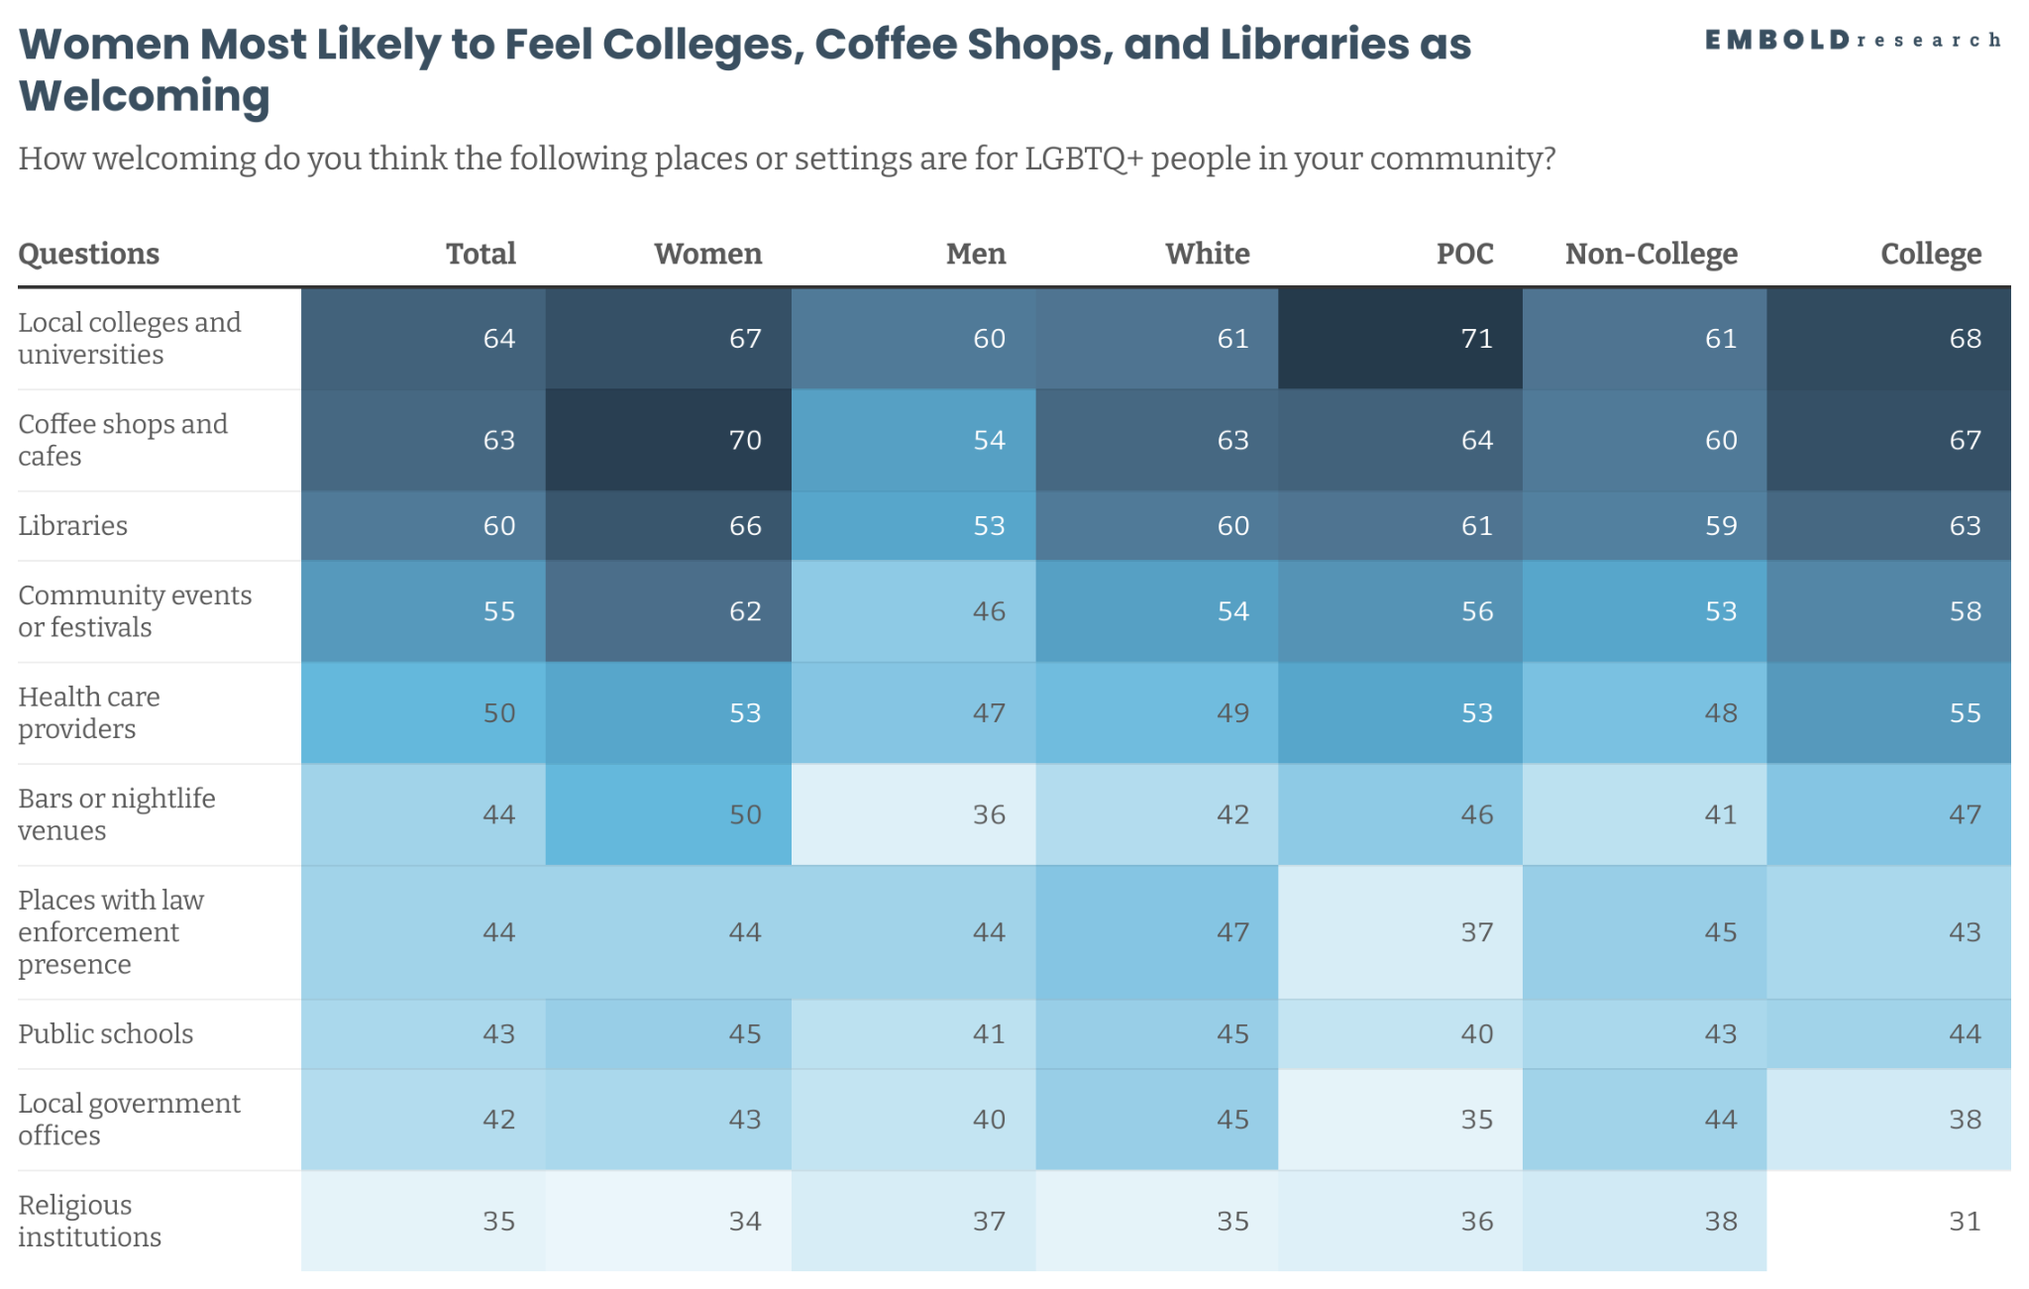
Qualitative Data Insight
According to interviews, spaces with more feminine and liberal cultural coding were often perceived as safe. Participants mentioned places like craft fairs with “spooky” themes and farmers markets as inclusive environments where they felt more comfortable expressing themselves.

Slide 11
Perceived Challenges for LGBTQ+ Youth And Needed Resources
Those closest to young peoples have growing concerns about the lack of youth spaces and changing support from adults in school systems

Slide 12
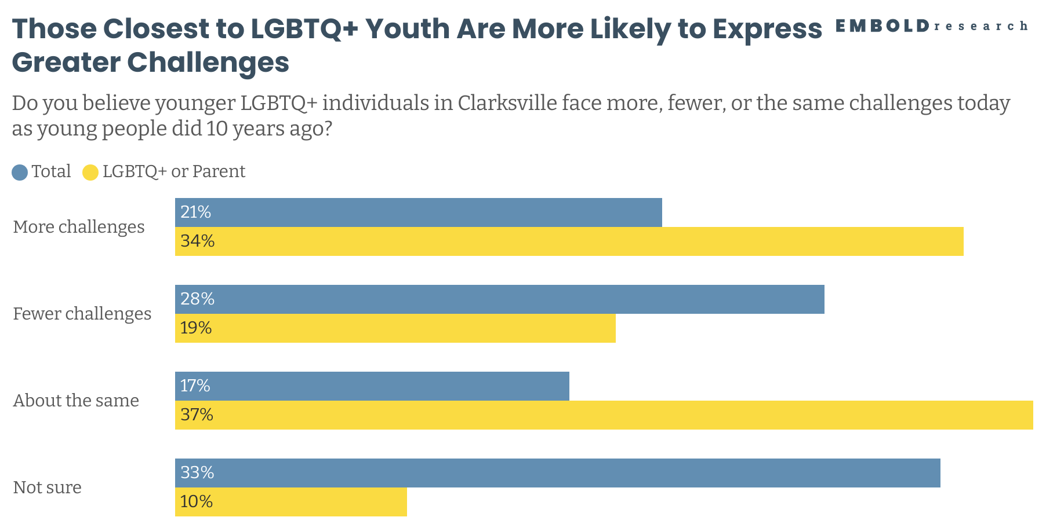
Qualitative Data Insight
Participants—particularly parents of LGBTQ youth—voiced increasing concern over school policies that exacerbate the isolation of vulnerable students. The interviews reveal a clear divide between youth with supportive, resource-rich home environments and those lacking such support. Policies are also limiting the ability of community actors to reach and assist the most vulnerable populations.

Slide 13
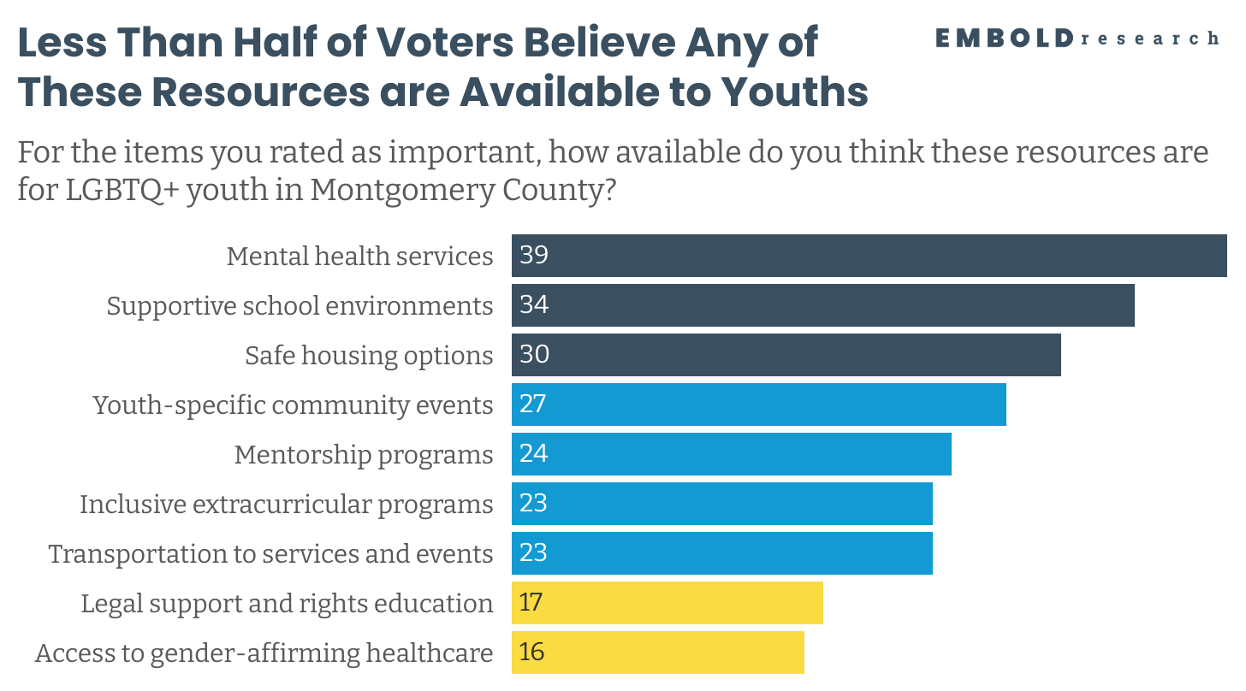
Qualitative Data Insight
The need for consistent, confidential, and queer-affirming spaces for youth—both physical and emotional—was clear across interviews. One participant said: Ever since I moved here, I have heard people… say there is nothing for kids to do that doesn't cost them money here.”

Slide 14
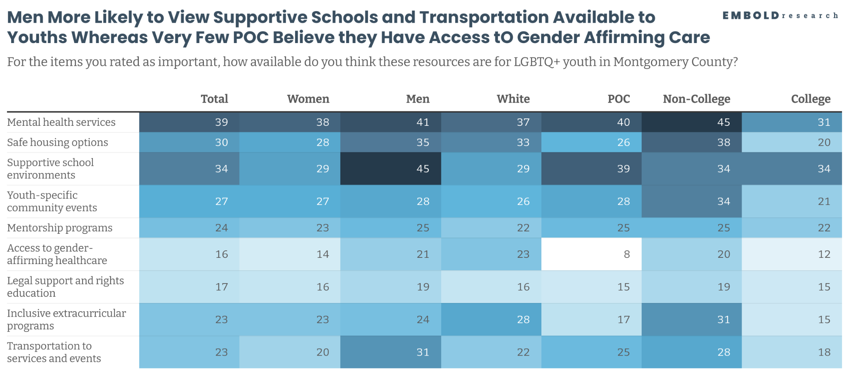
Qualitative Data Insight
Interviews highlight that schools, which were once safe spaces where youth experiencing challenges with their identity at home could find support from adults, are increasingly constrained by policies that make such support more difficult. Alternatively, peers are now often described as more supportive.

Slide 15
Path Forward:
Better Communication about Community Events Hosted in Spaces Perceived as Welcoming.
Notes:
Michelle begins, and brings it home

Slide 16
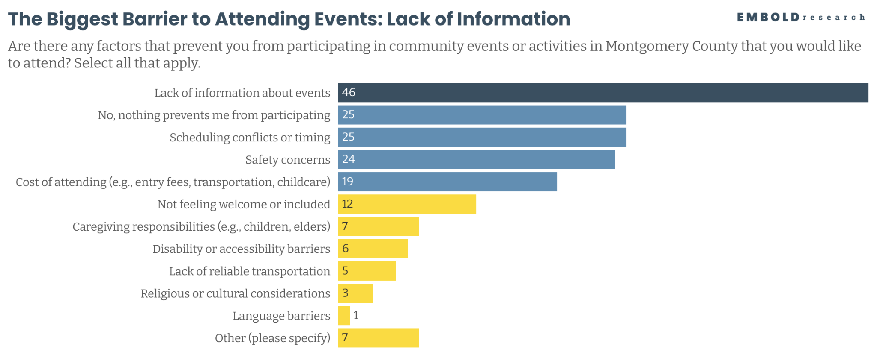
Qualitative Data Insight
Lack of information was frequently underscored in interviews with one participant highlighting: “It really is a lot of it word of mouth. … You really have to be in the know to even like expect that to be a thing you could find. …”

Slide 17
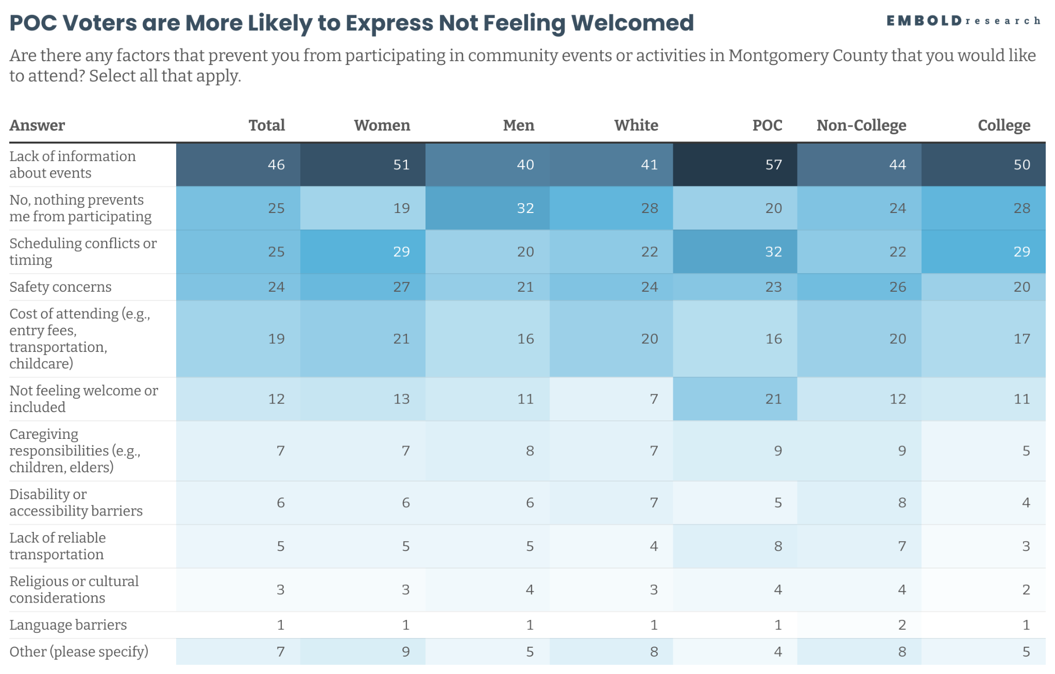
Qualitative Data Insight
Interviews noted barriers within community spaces for people with multiple marginalized identities. One participant said: “even if you're openly okay with gay people, you might not be okay with black people or vice versa.”

Slide 18
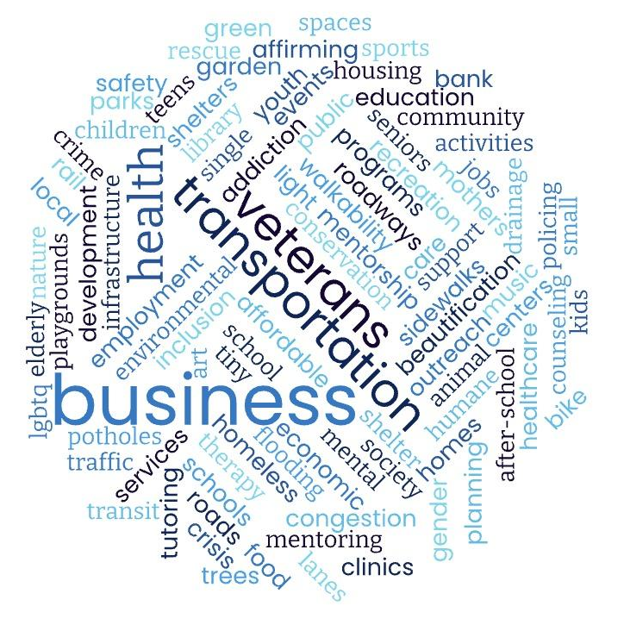
If you were given $1 million to invest, what would you do..?
Infrastructure & Traffic: Road repairs, congestion relief, drainage improvements, sidewalks, better planning
Youth & Education Support: After-school programs, mentorship, youth centers, school funding, alternative education pathways
Housing & Homelessness: Affordable housing, shelters, tiny home villages, support for veterans, addressing homelessness
Mental & Physical Health Services: Mental health access, healthcare facilities, crisis support, addiction treatment, gender-affirming care
Community Spaces & Recreation: Parks, playgrounds, sports facilities, community centers, beautification projects, art programs

Slide 19
RECOMMENDATIONS
Create Free, Inclusive Youth Programs
Develop accessible, affirming activities—such as art nights, sports leagues, and volunteer opportunities—led by adults trained in inclusion, so all youth feel safe and welcome.
Expand Safe, Confidential Youth Spaces
Since schools are increasingly constrained, invest in alternative venues like community centers, libraries, and other public spaces to provide consistent, queer-affirming support for youth.
Strengthen Mental Health and Mentorship Supports
Prioritize confidential, affordable, and affirming mental health services, alongside mentorship programs and after-school opportunities that connect youth with supportive peers and adults.
Improve Communication and Accessibility
Promote youth-focused events and resources through clear, centralized, and widely accessible channels—not just word-of-mouth or social media—and ensure all programs are financially and physically accessible.

Slide 20
RECOMMENDATIONS
Establish a Dedicated LGBTQ+ Community Center: Prioritize creating a fully accessible, centrally located community center that offers 24-hour safe space, mental health support, crisis response, and cultural programming designed by and for LGBTQ+ residents.
Expand Alternative Safe Spaces for Youth Support: Recognizing that schools are increasingly constrained by legislation, invest in community centers, libraries, and other public venues to host inclusive, confidential, and affirming programs where LGBTQ+ youth can safely connect with peers and trusted adults.
Center Intersectional Inclusion in All Efforts:
Recognize and address the differences in experience between LGBTQ+ individuals who can “pass” and those whose queerness intersects with other marginalized identities like race, disability, or immigration status, ensuring programs and spaces are intentionally designed to be inclusive and affirming for all.

Slide 21
Follow Up
Clarksville Q Town Hall: September 6th 6:00 PM, Clarksville Montgomery County Library

